Slide 1


Slide 2
OUTLINE
Introduction to FIMA
FIMA Global Relief Efforts
Sharing Experiences on Total Disaster Management (TDM) & Advocacy roles
Opportunities to be part of or partner with FIMA Relief
Conclusions

Slide 3


Slide 4
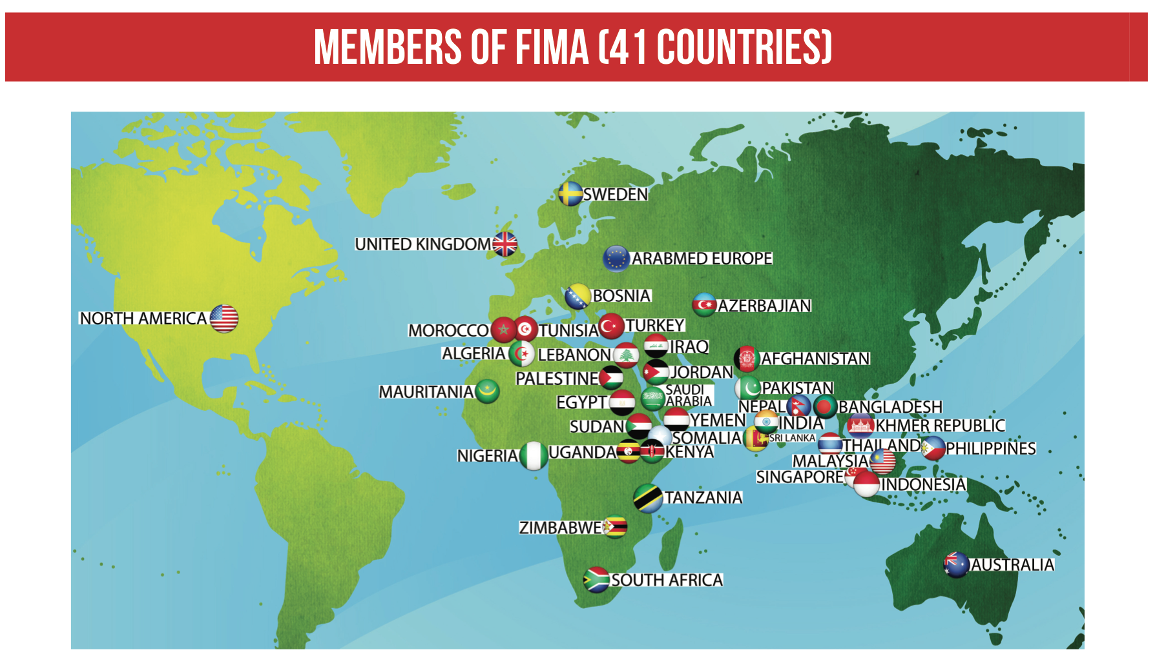

Slide 5


Slide 6
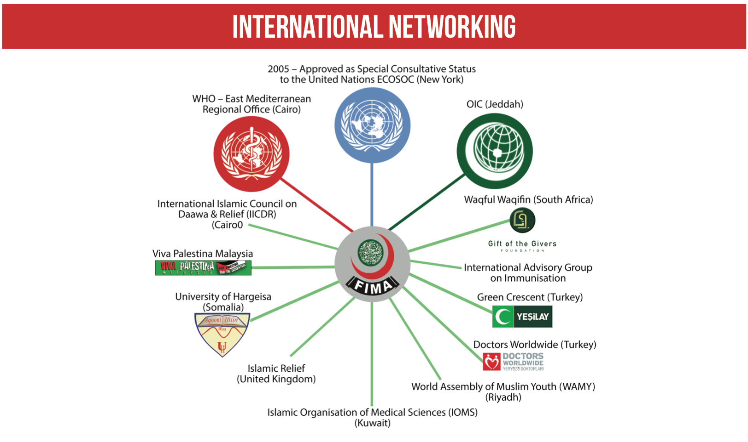

Slide 7
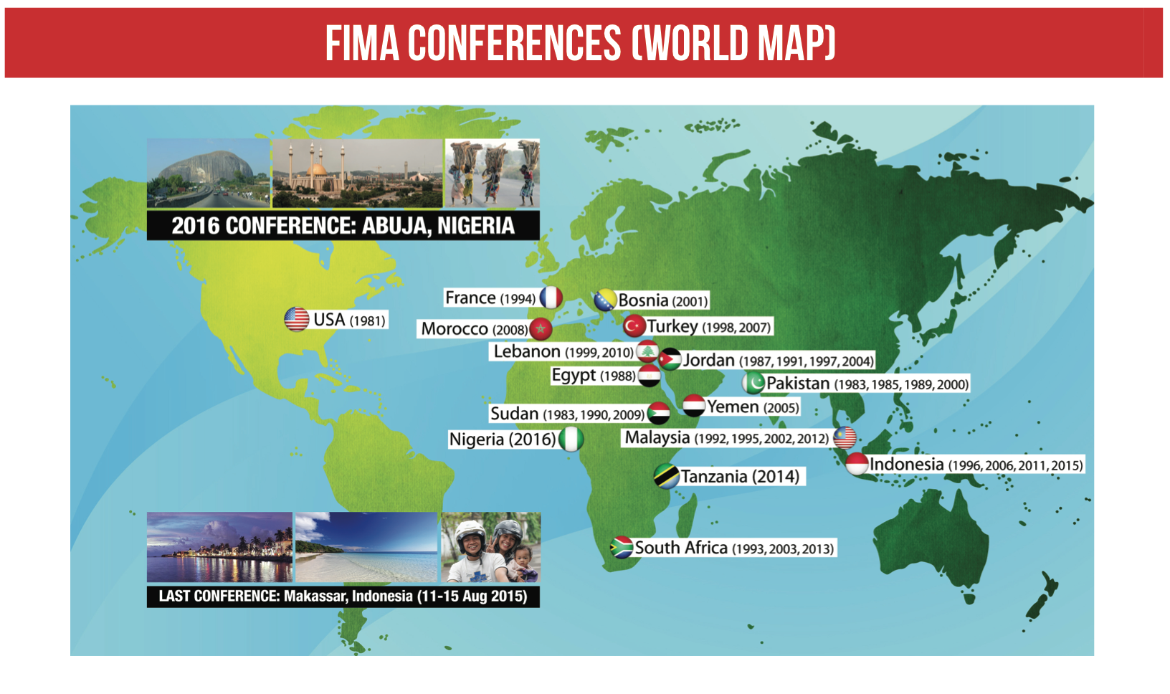

Slide 8
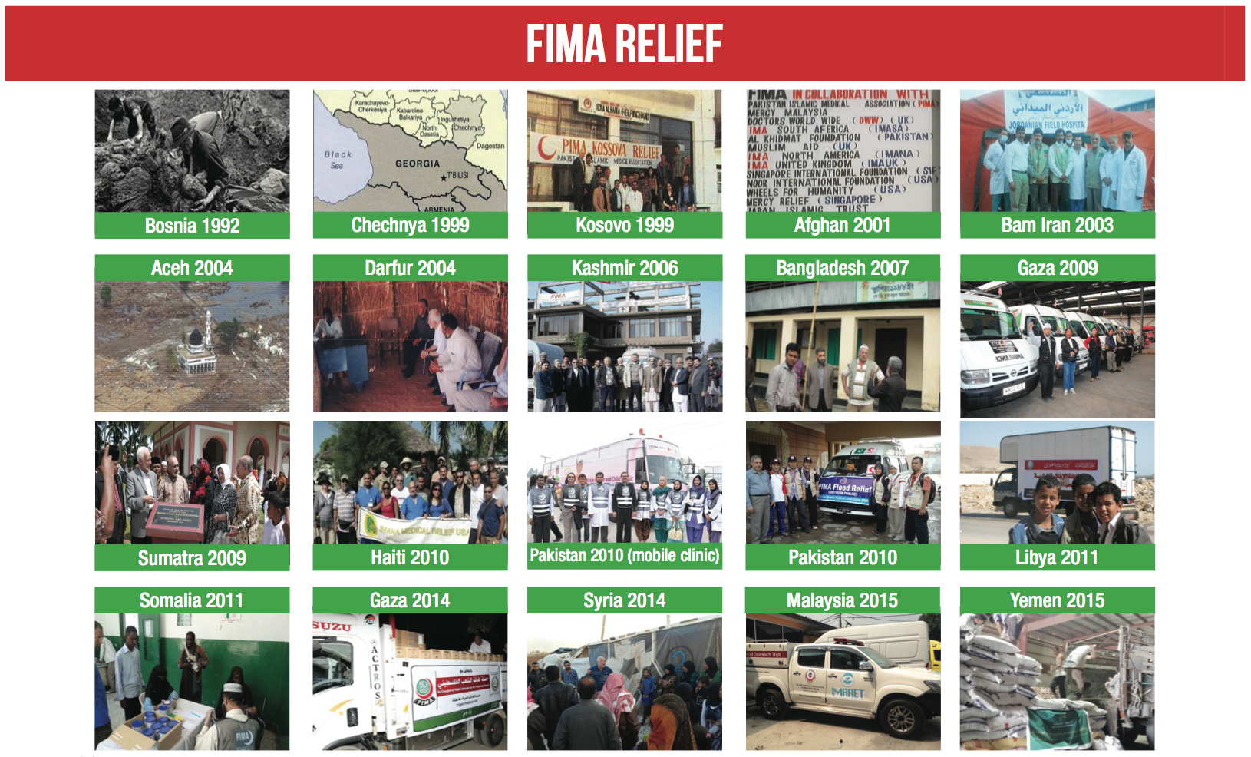

Slide 9


Slide 10
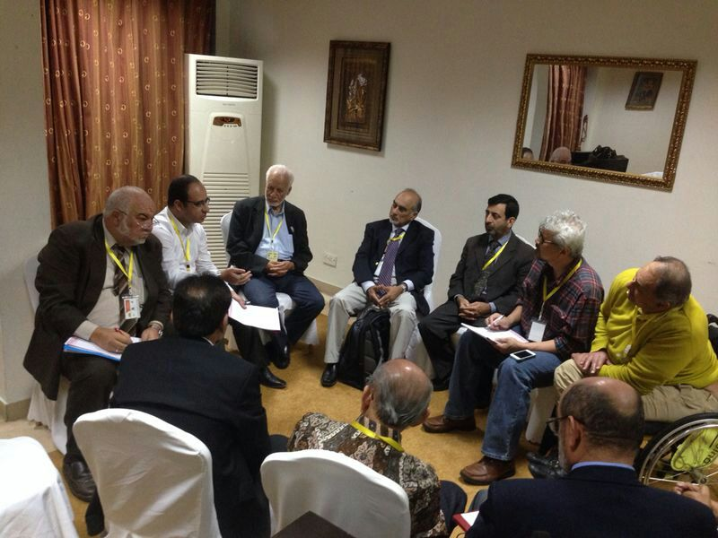
TOTAL DISASTER MANAGEMENT
SHARED KNOWLEDGE, EXPERTISE & EXPERIENCE

Slide 11

TDM
CONSOLIDATE WITH PARTNERSHIP

Slide 12
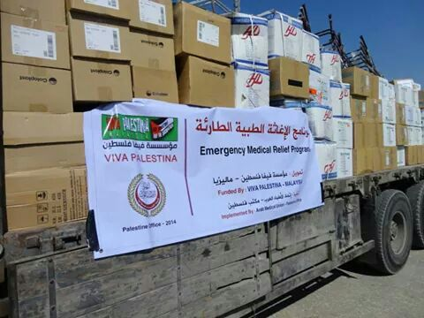

Slide 13
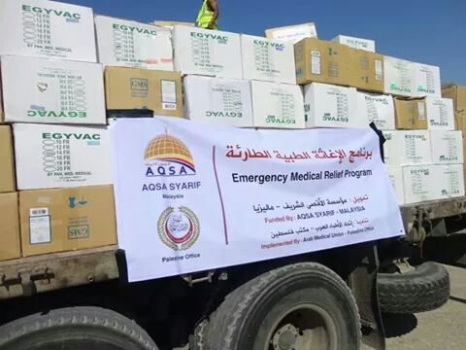

Slide 14
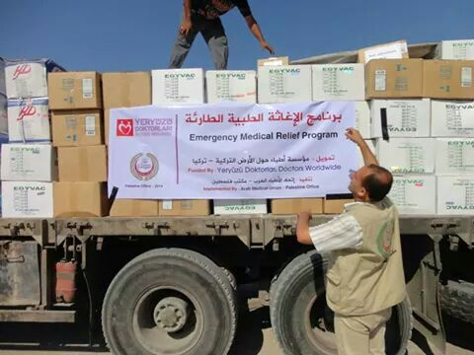

Slide 15
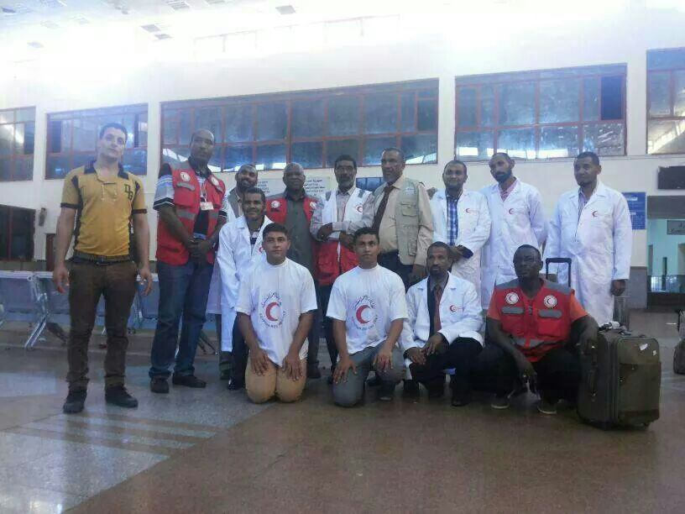
EMERGENCY PHASE – PRIORITY SETTING

Slide 16
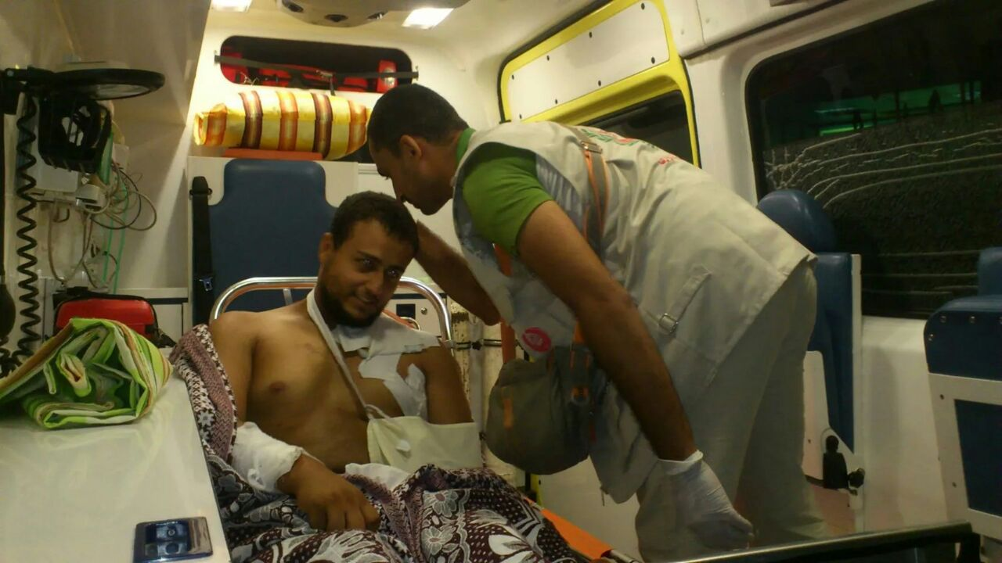
TDM: EMPOWERING

Slide 17
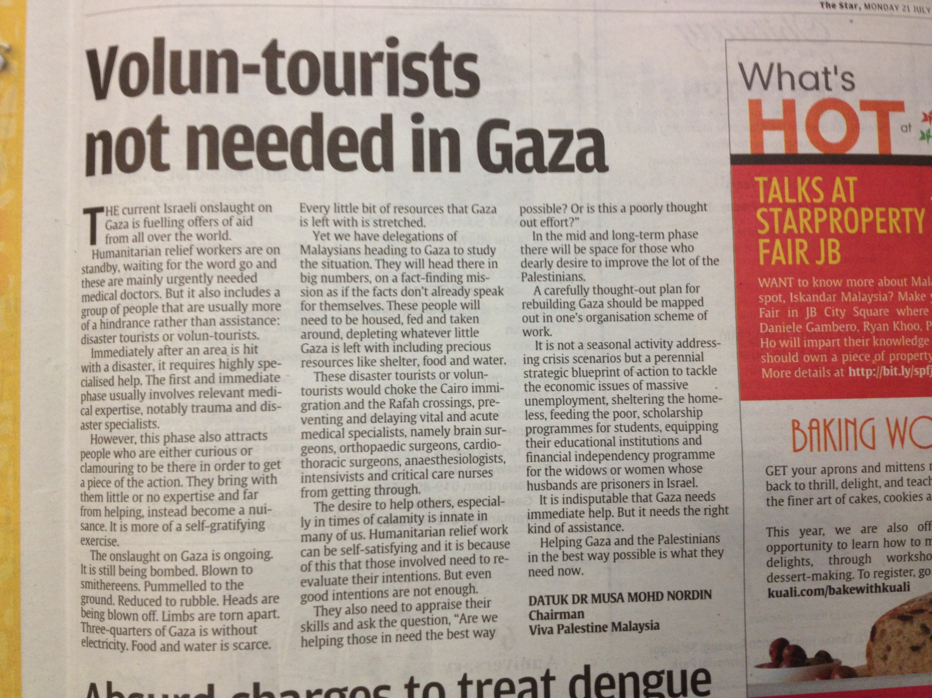
DISASTER TOURISTS

Slide 18
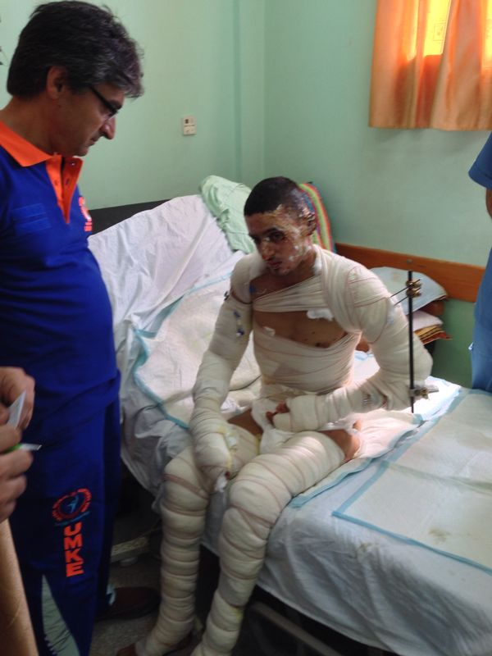
TDM
BEST MEDICAL & SURGICAL PRACTICES

Slide 19
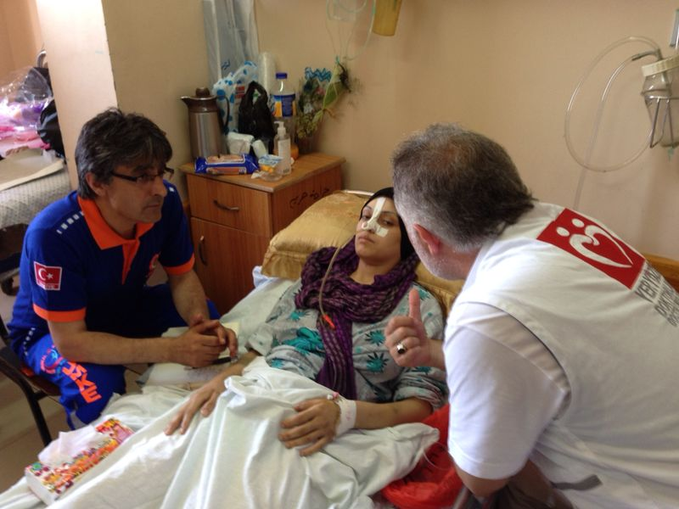

Slide 20
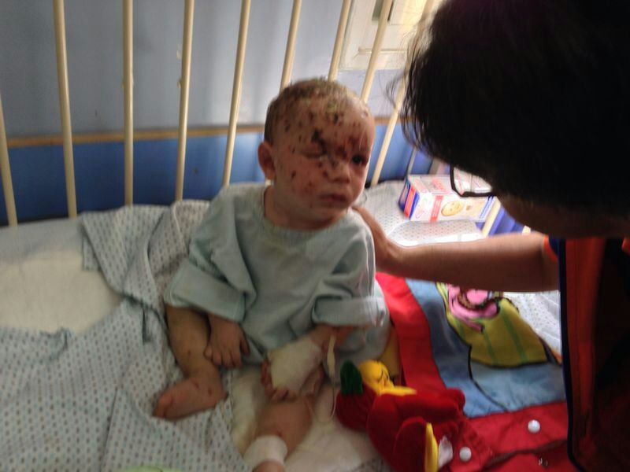

Slide 21
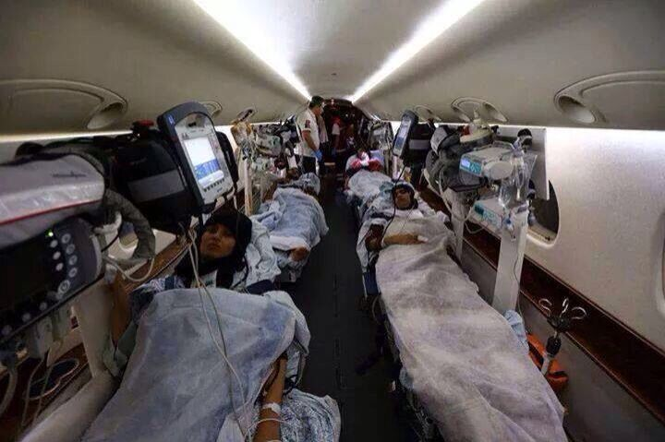

Slide 22
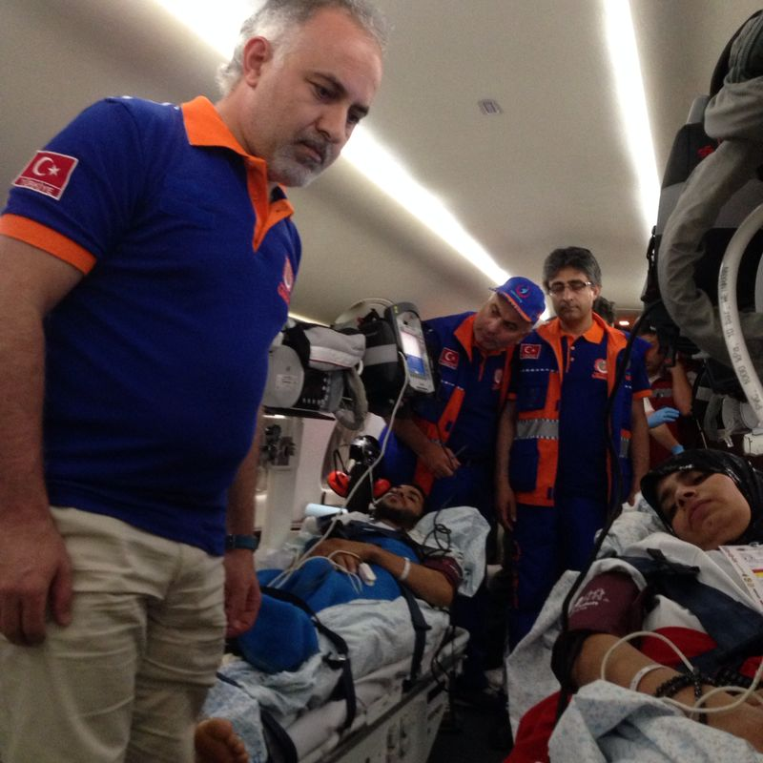

Slide 23
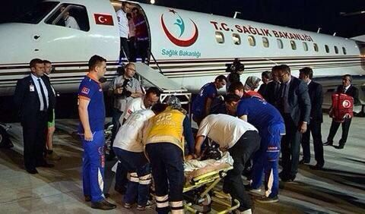

Slide 24
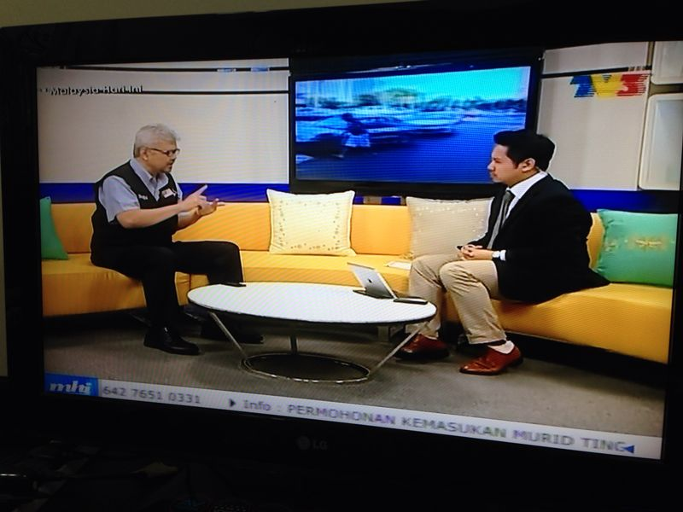
ADVOCACY
AWARENESS & OWNERSHIP

Slide 25
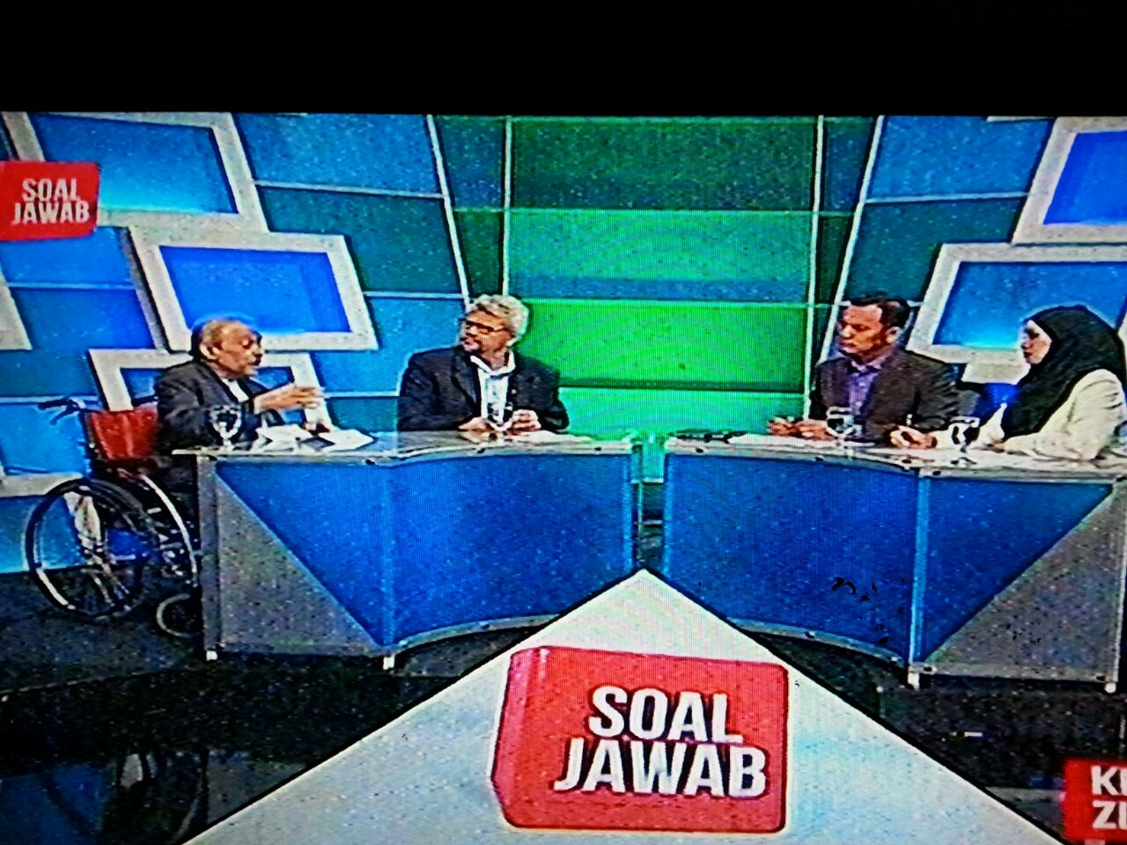

Slide 26
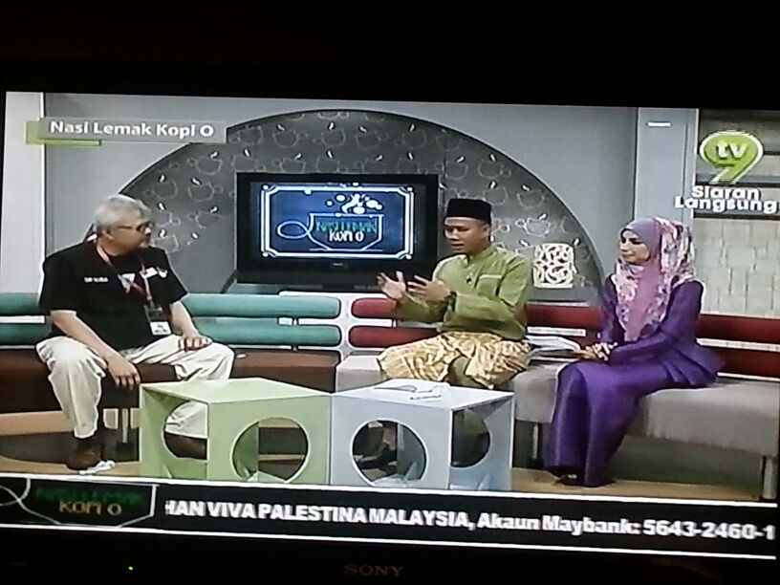

Slide 27

ADVOCACY
VARIETY OF PLATFORMS – CALL TO ACTION!

Slide 28


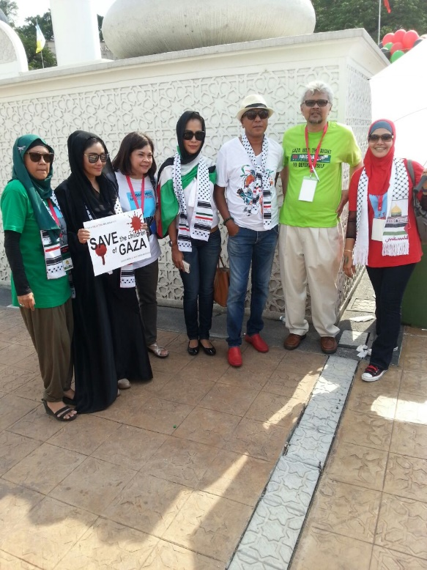
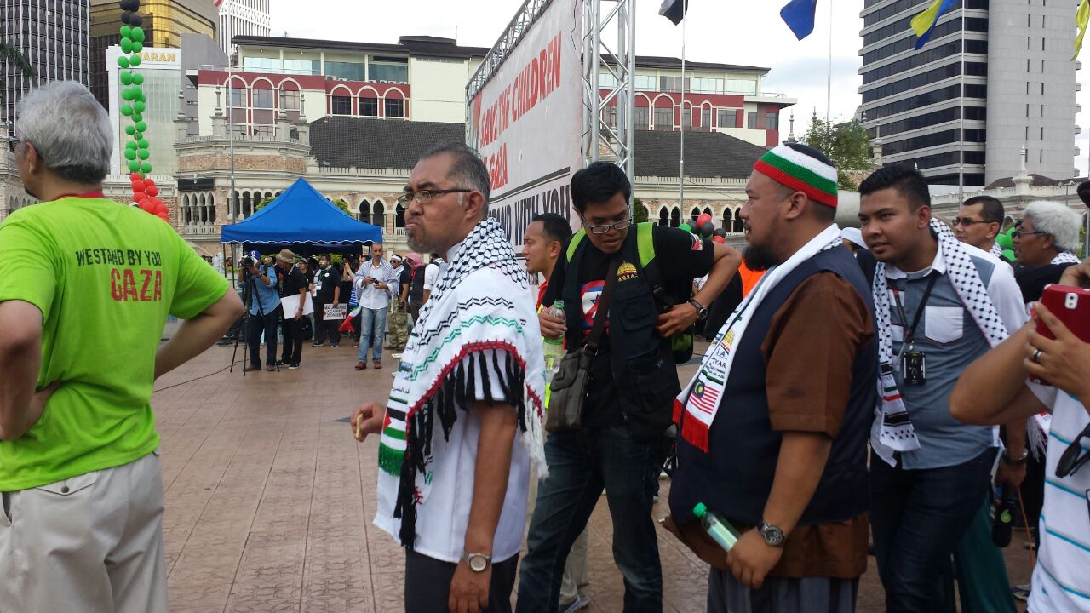

ADVOCACY
INVOLVE ALL STAKEHOLDERS

Slide 29


Slide 30
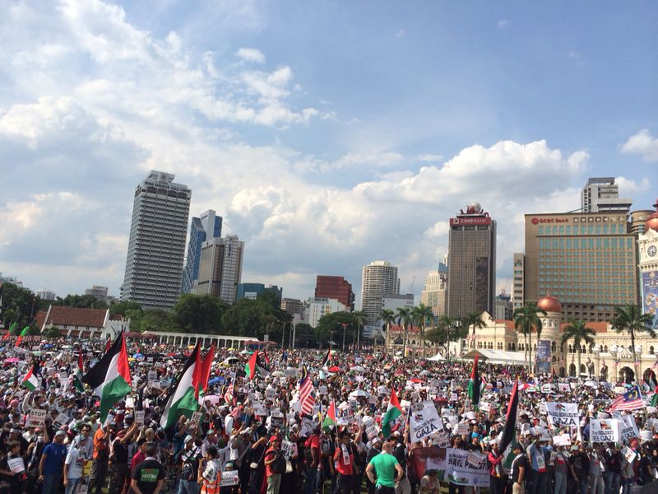
GROUND SWELL

Slide 31
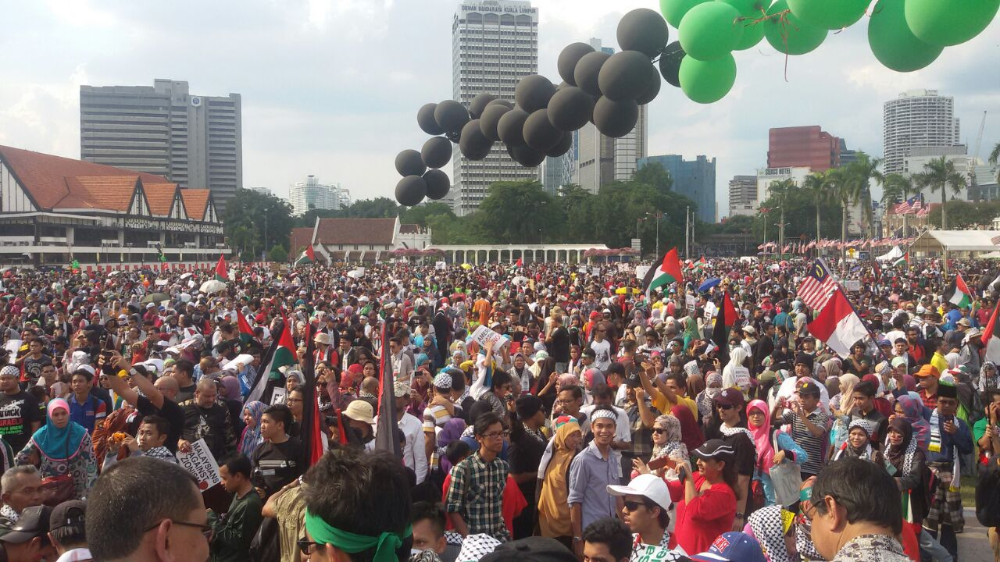

Slide 32
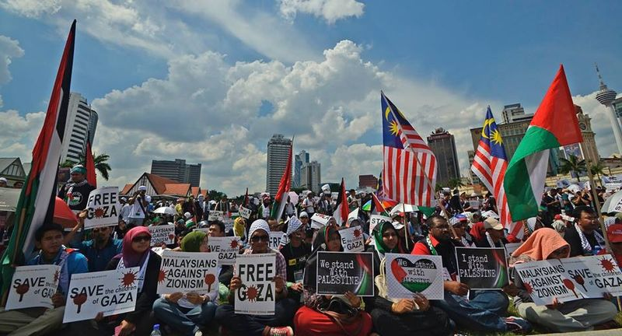

Slide 33
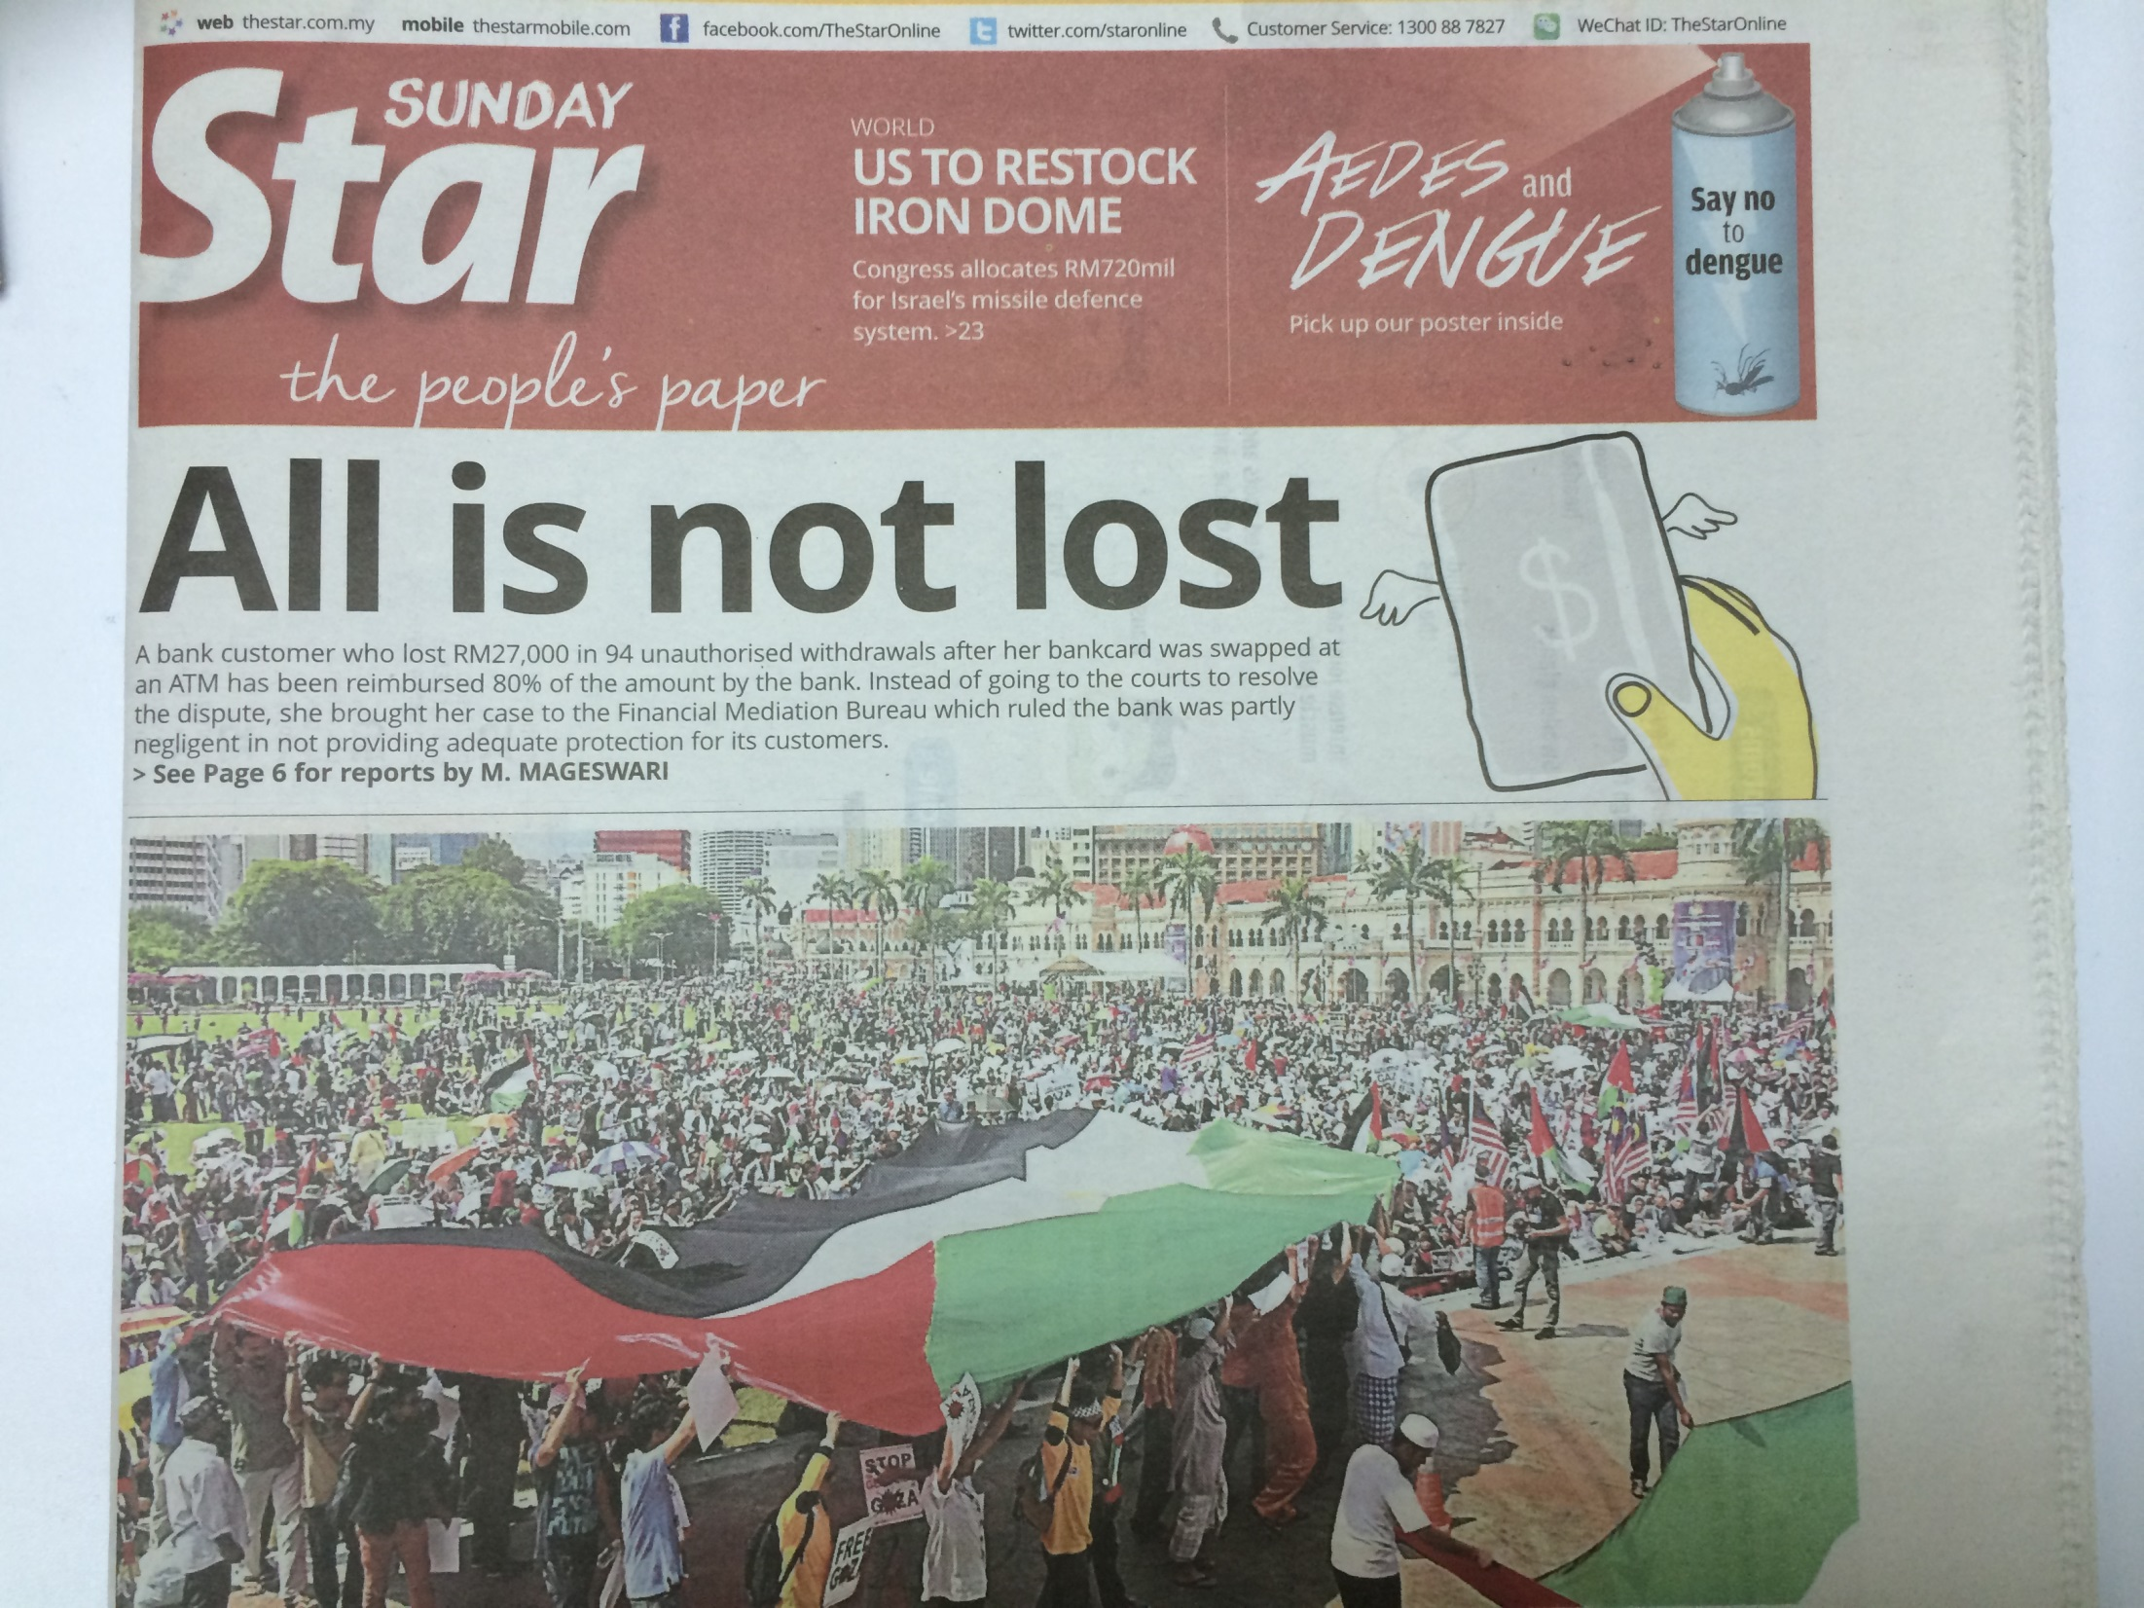
MEDIA PRESENCE

Slide 34


Slide 35


Slide 36
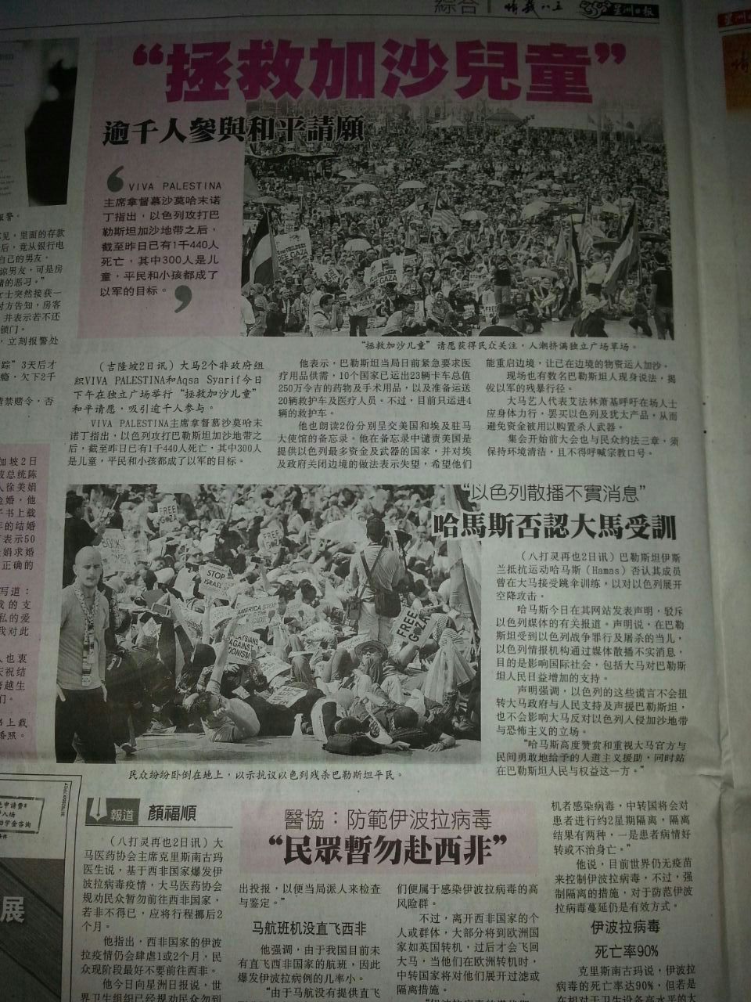
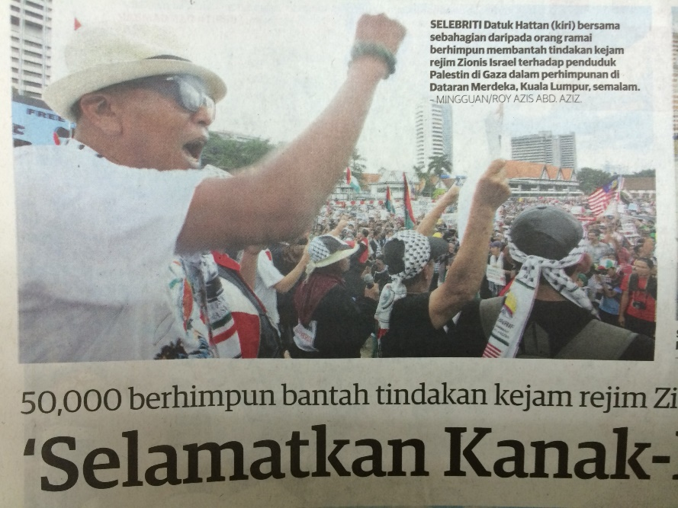
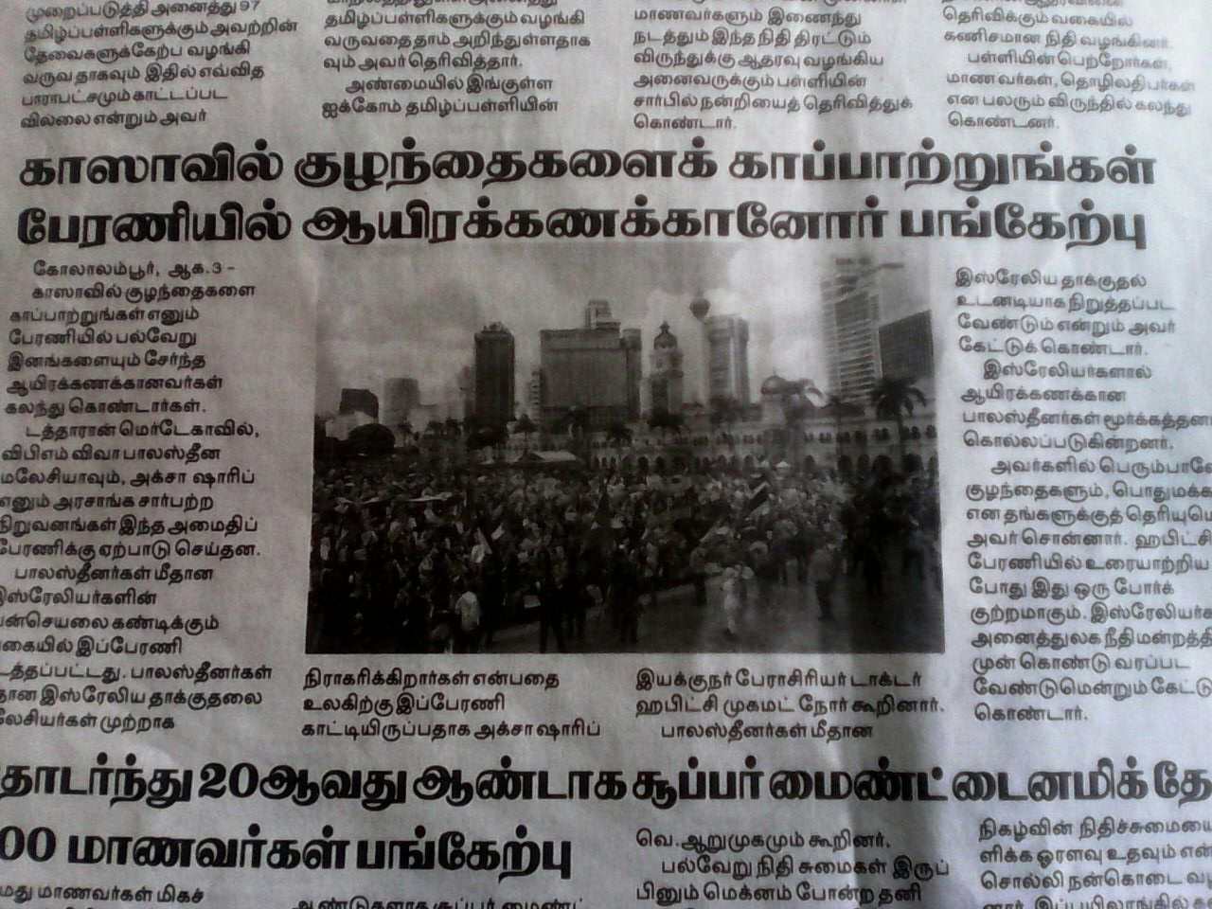
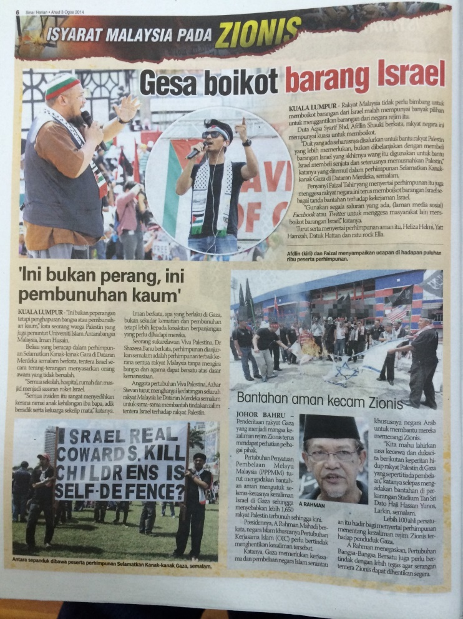
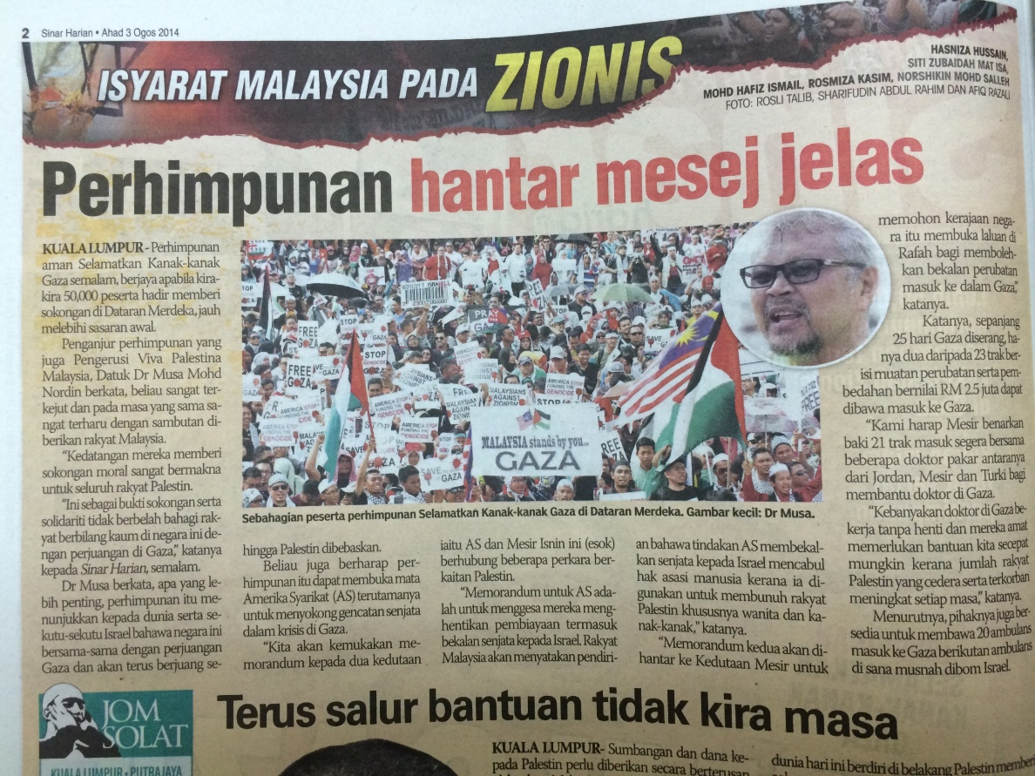


Slide 37
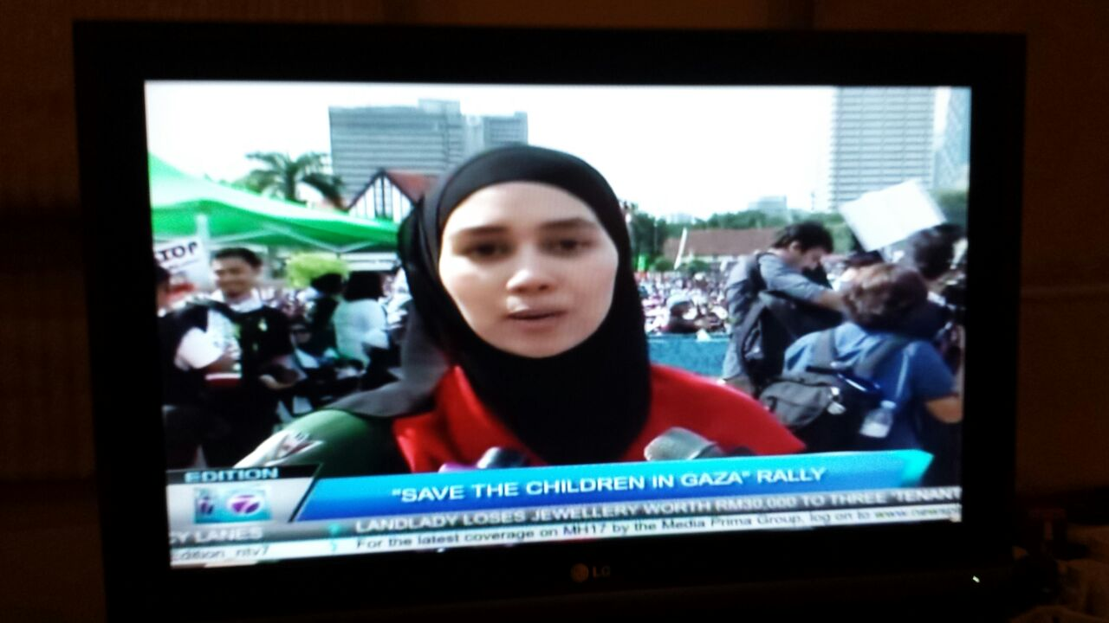
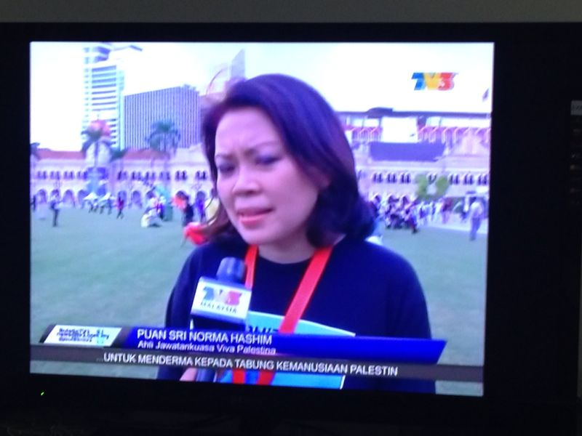
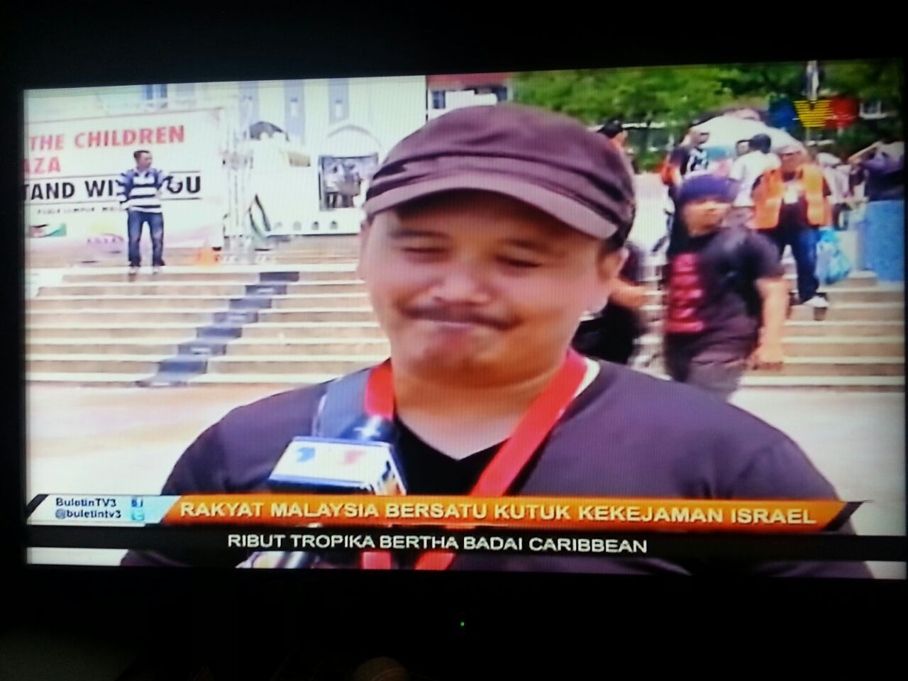
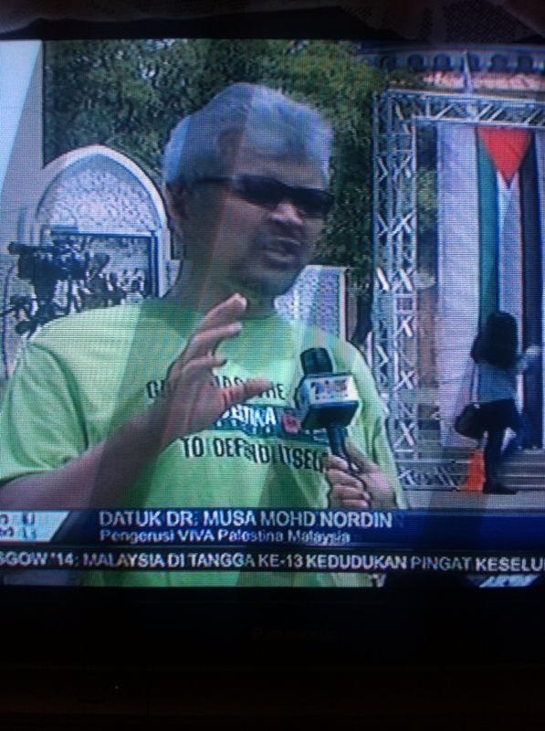

Slide 38


Slide 39
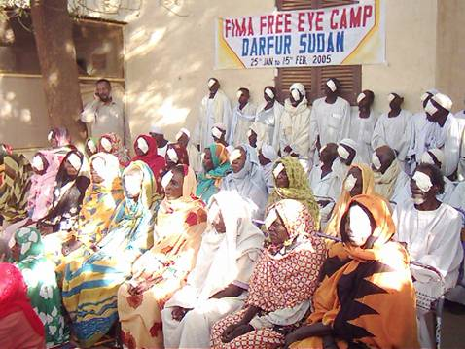

Slide 40
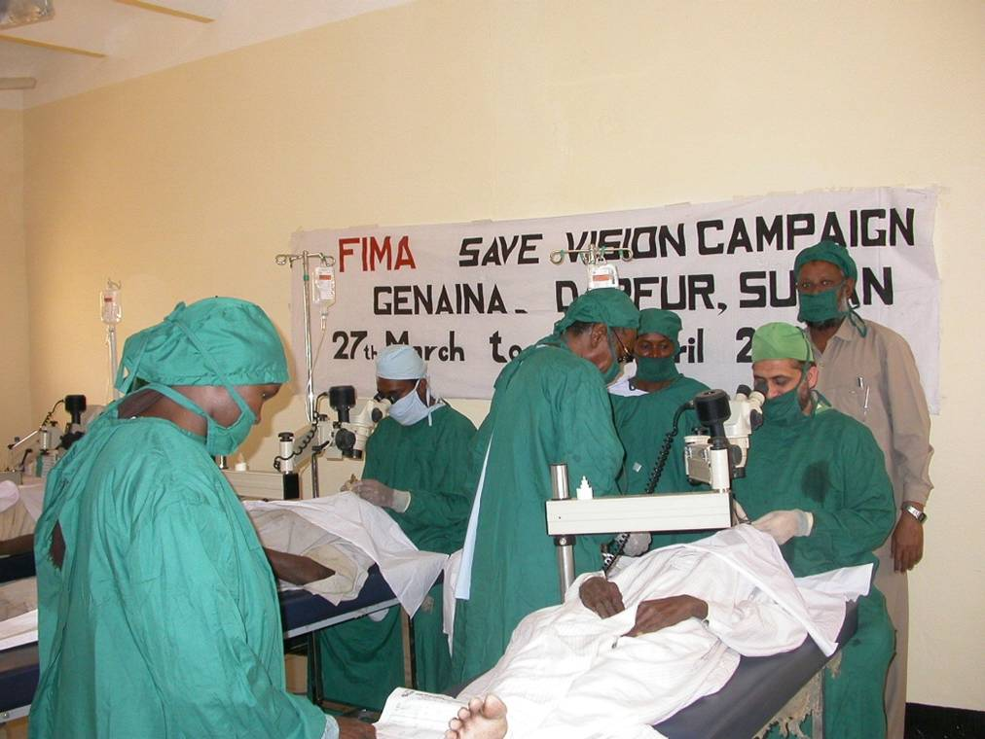

Slide 42
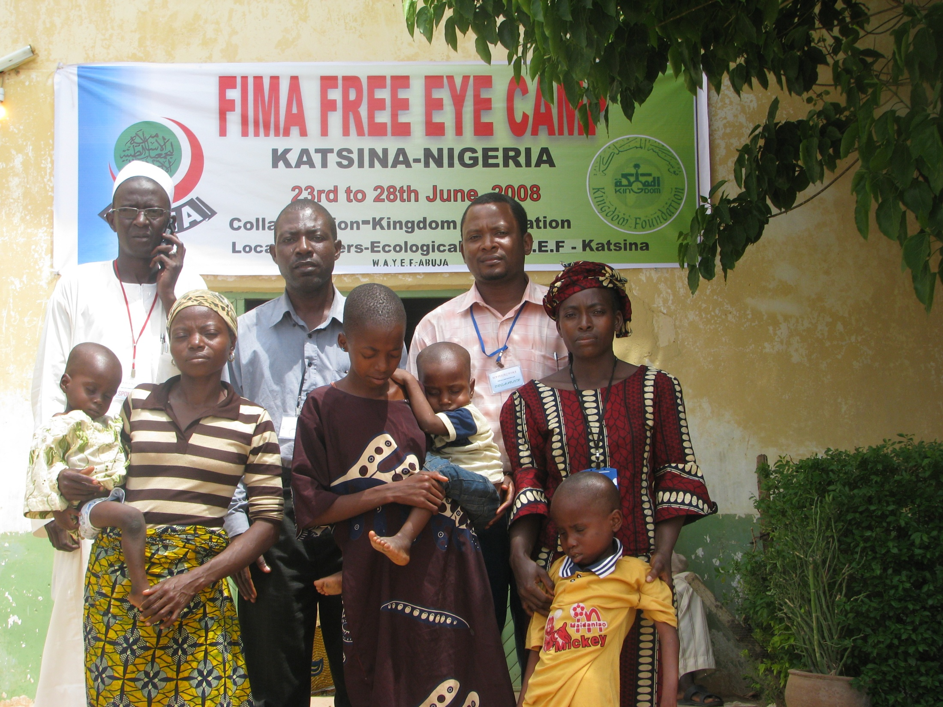

Slide 43
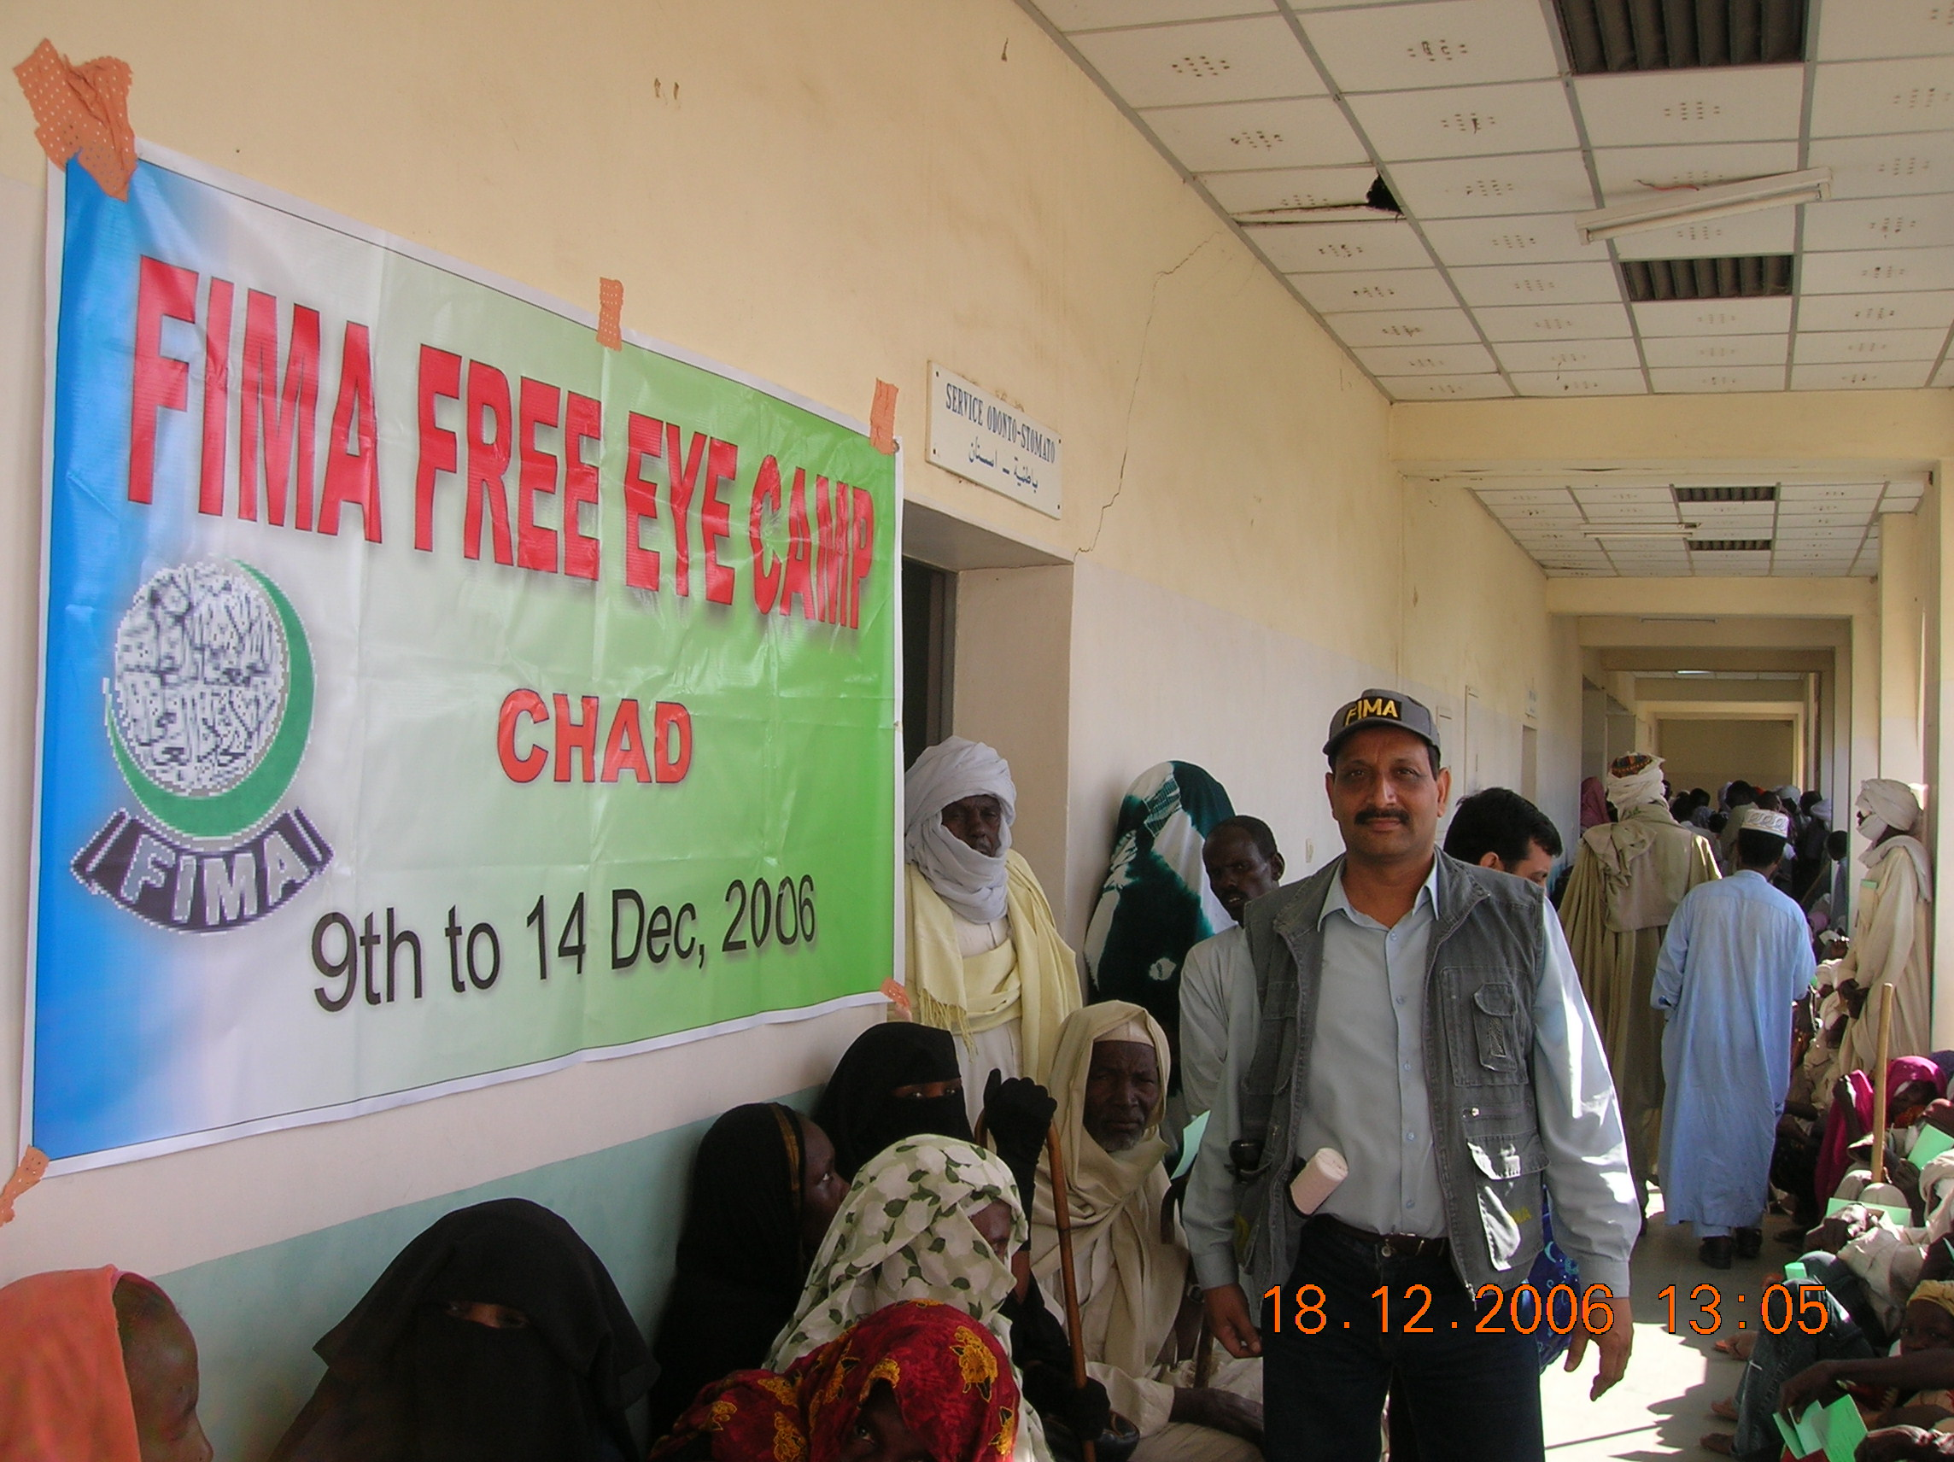

Slide 44
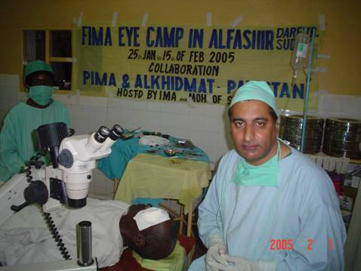

Slide 45
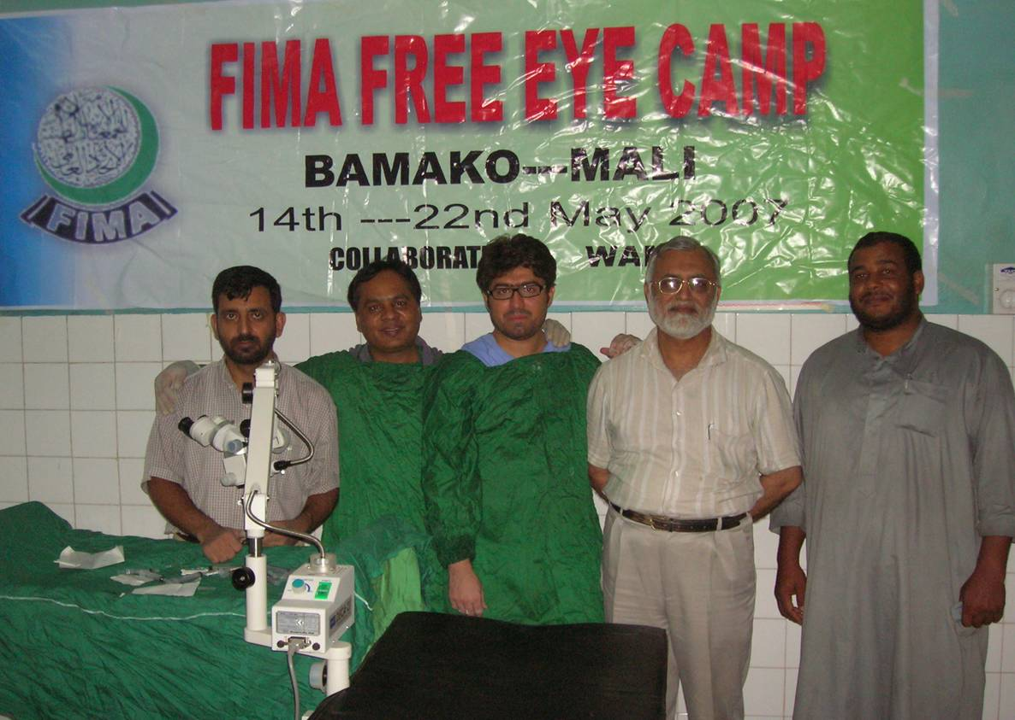

Slide 47
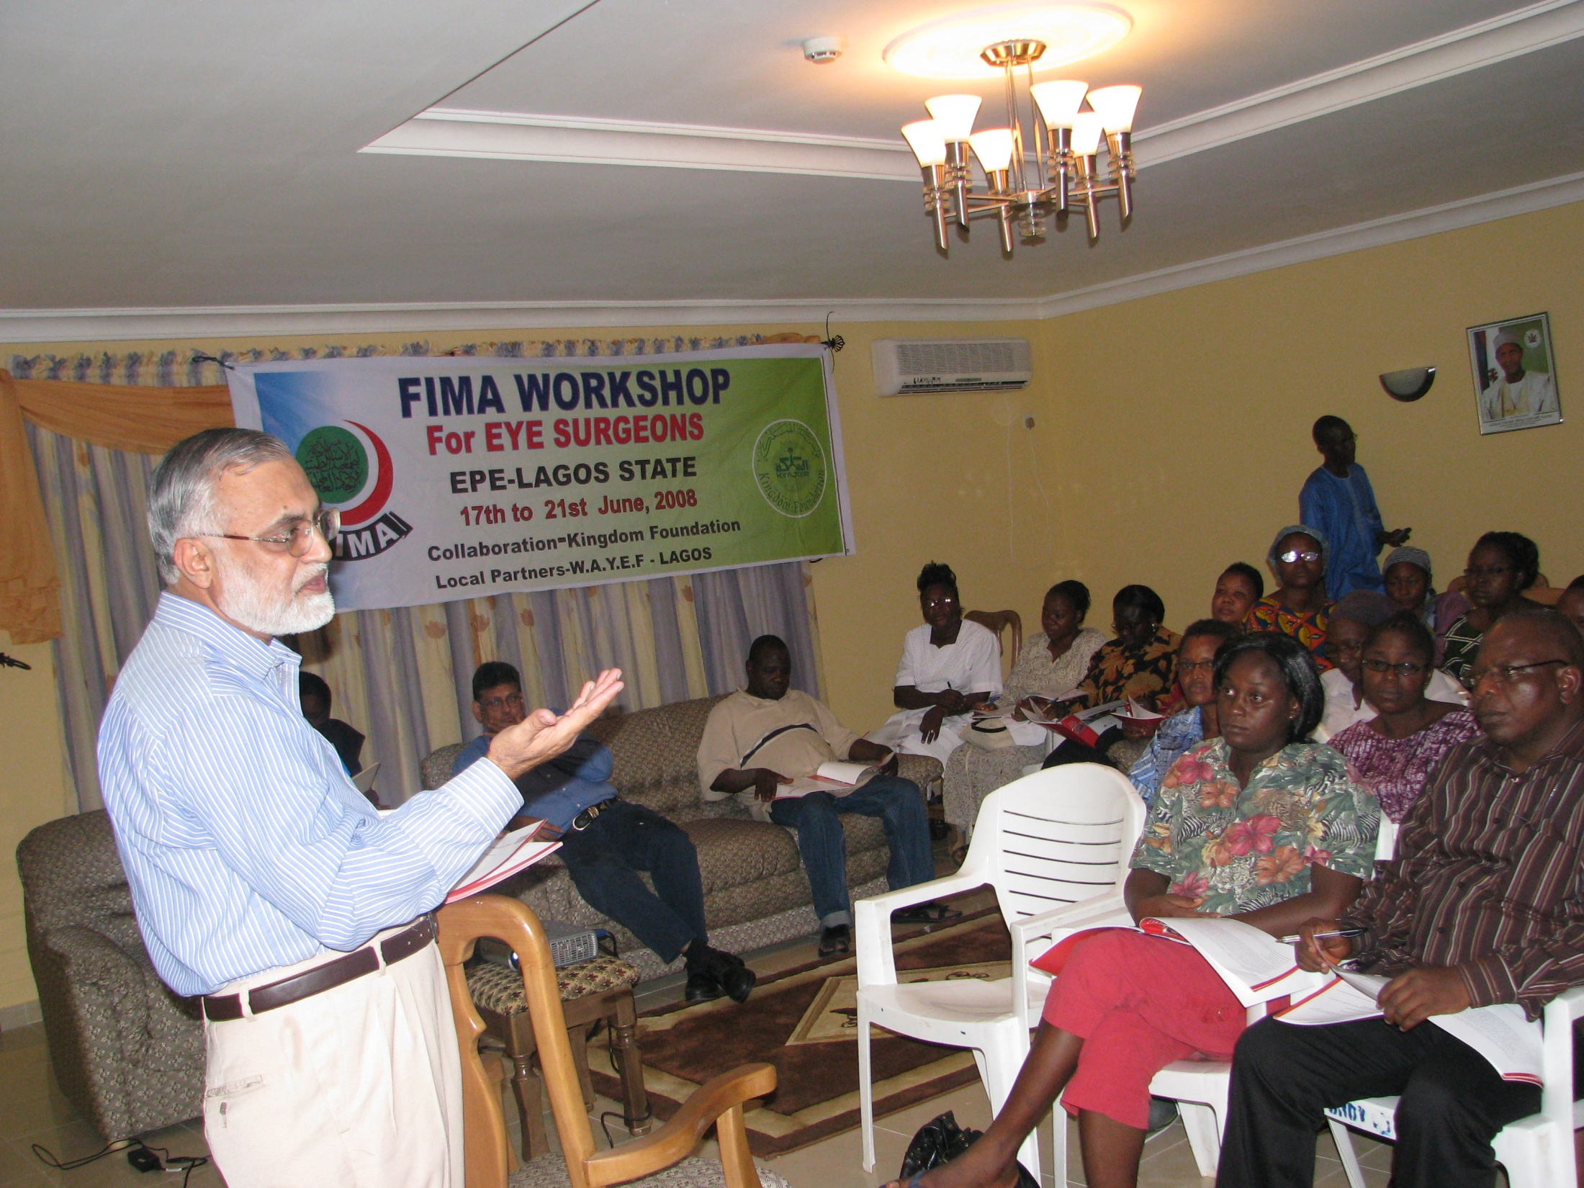
CAPACITY BUILDING

Slide 48
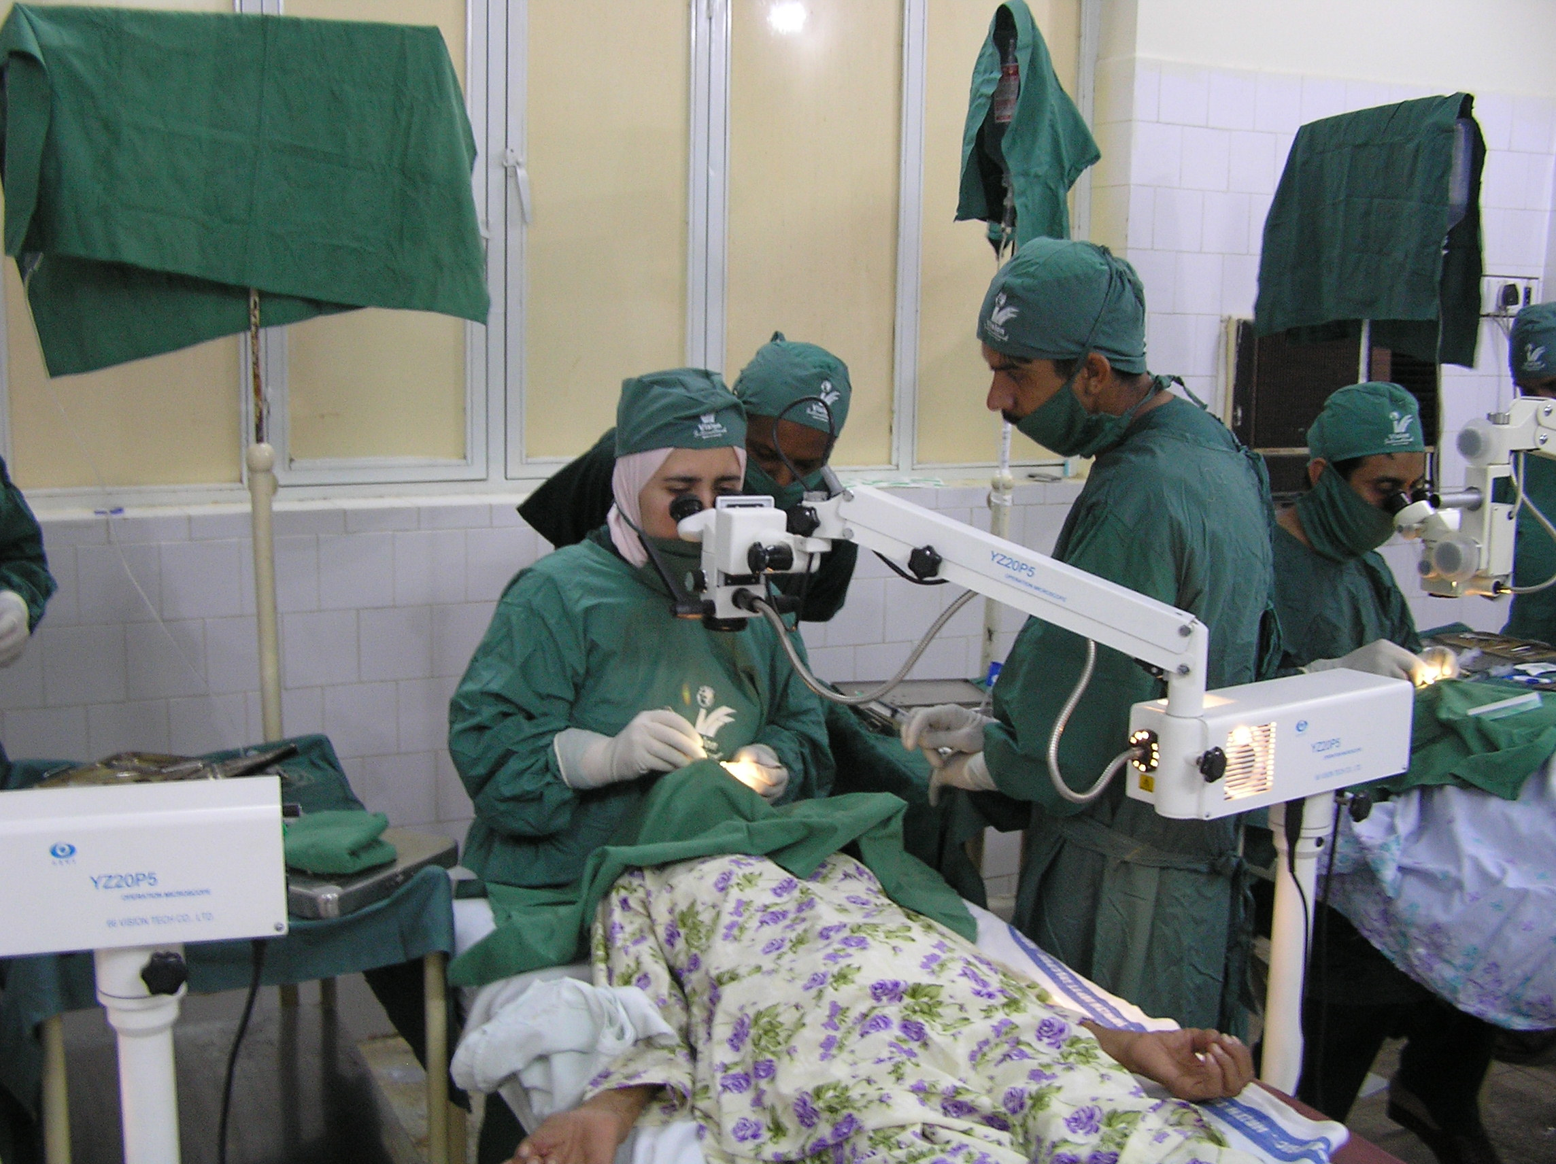

Slide 49
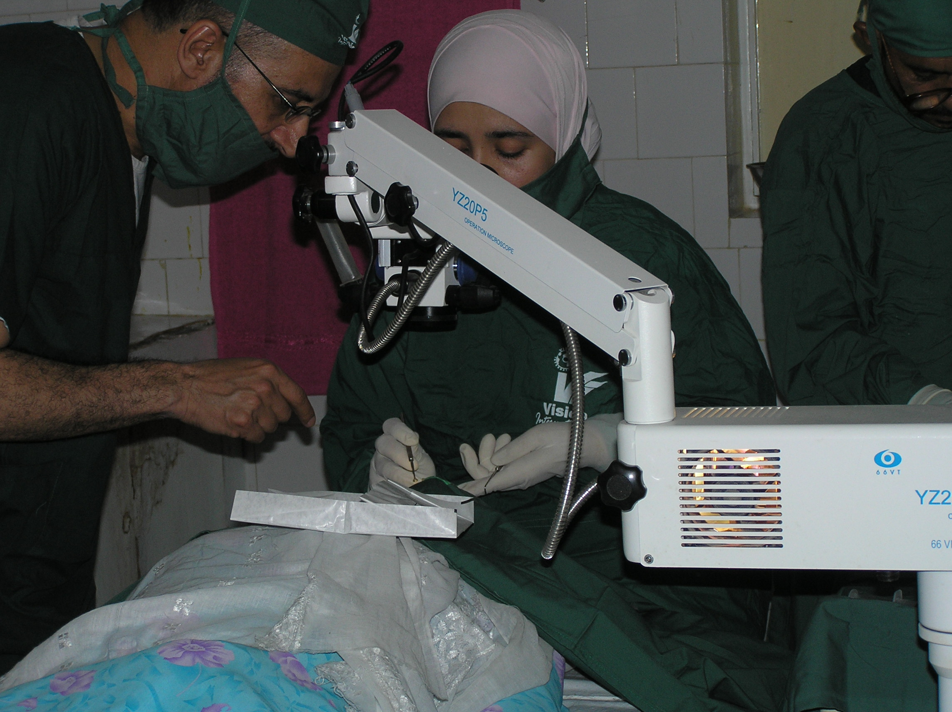

Slide 50
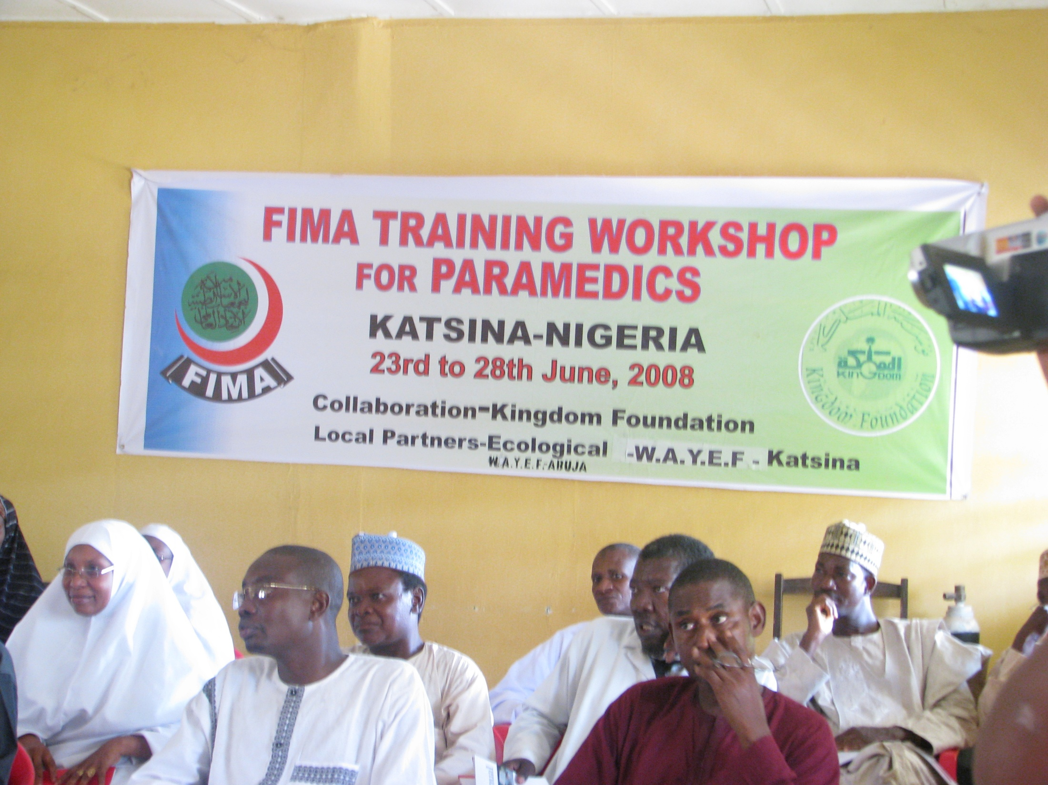

Slide 51
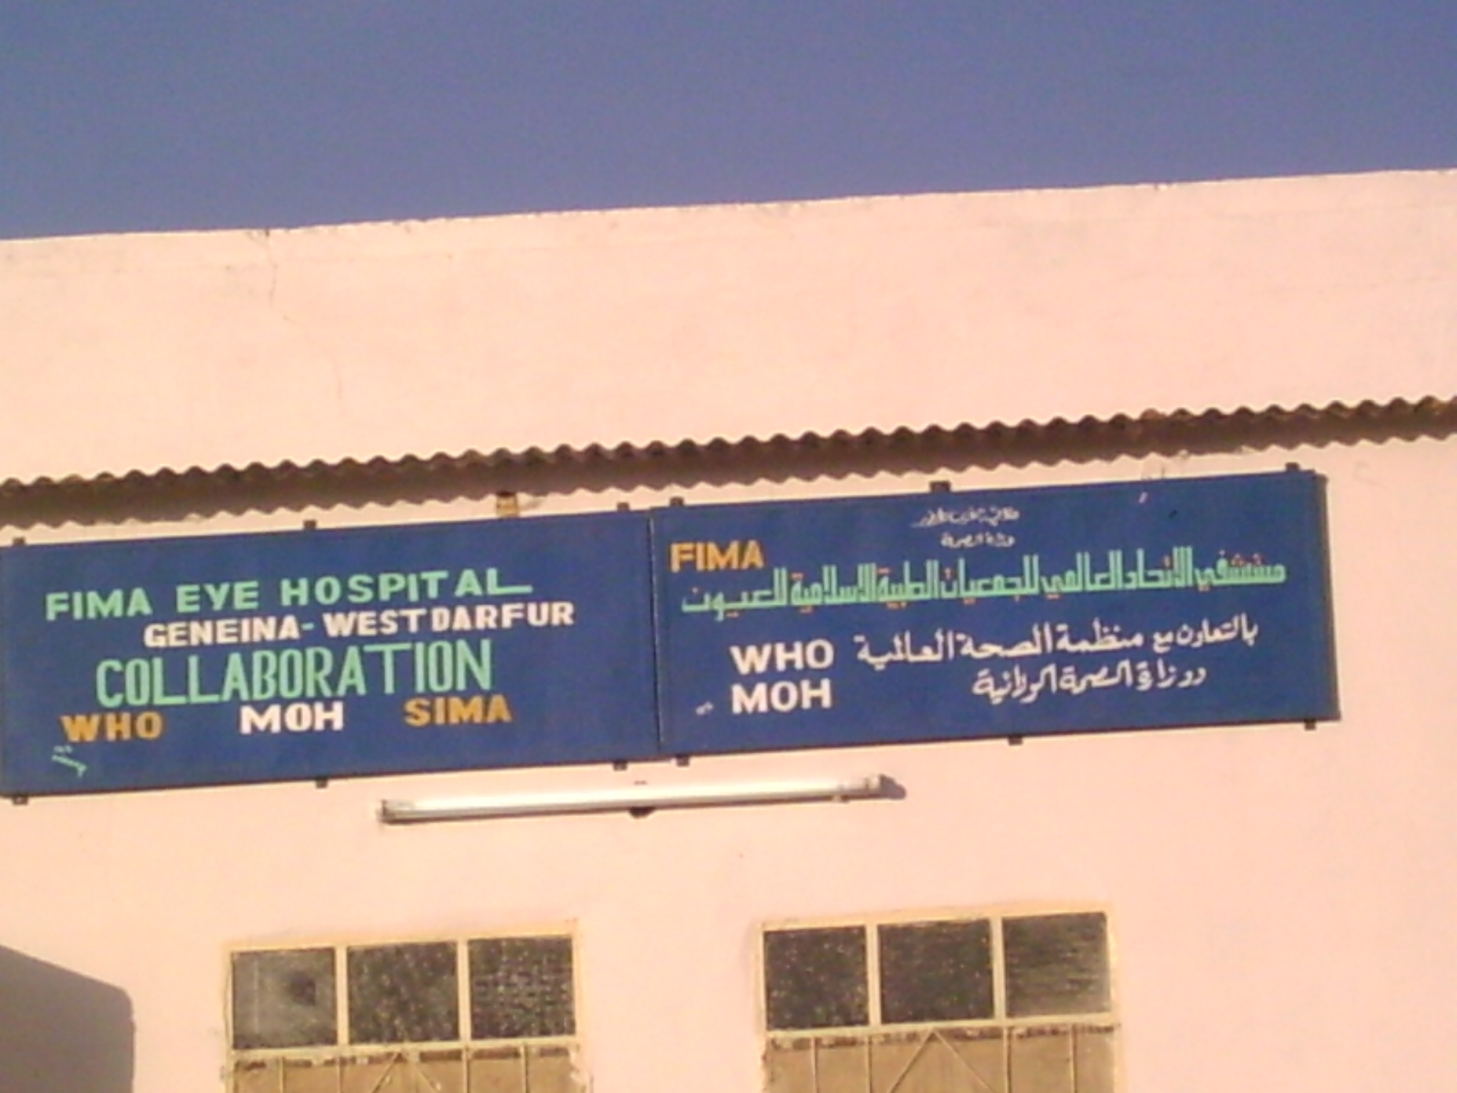

Slide 52
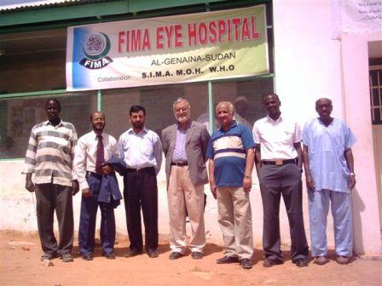

Slide 53
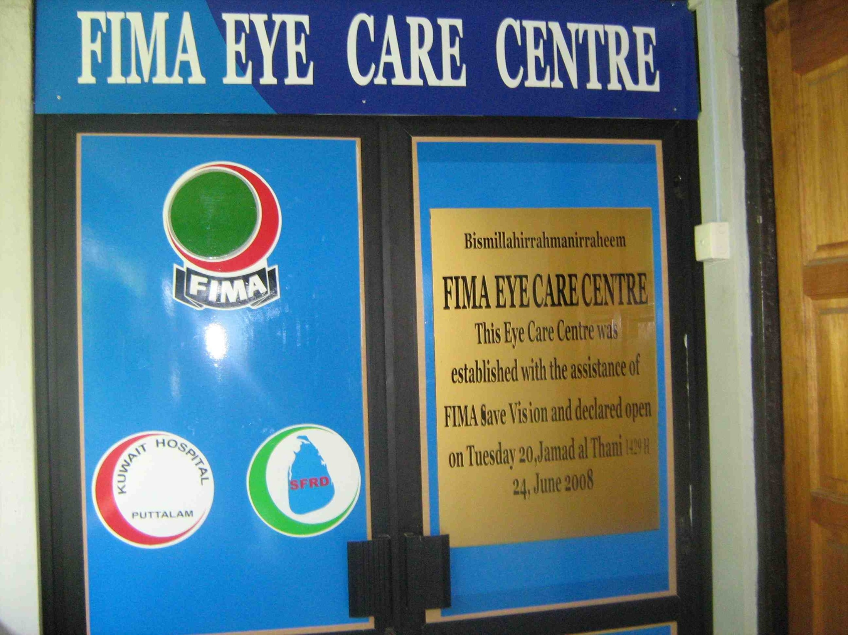

Slide 54
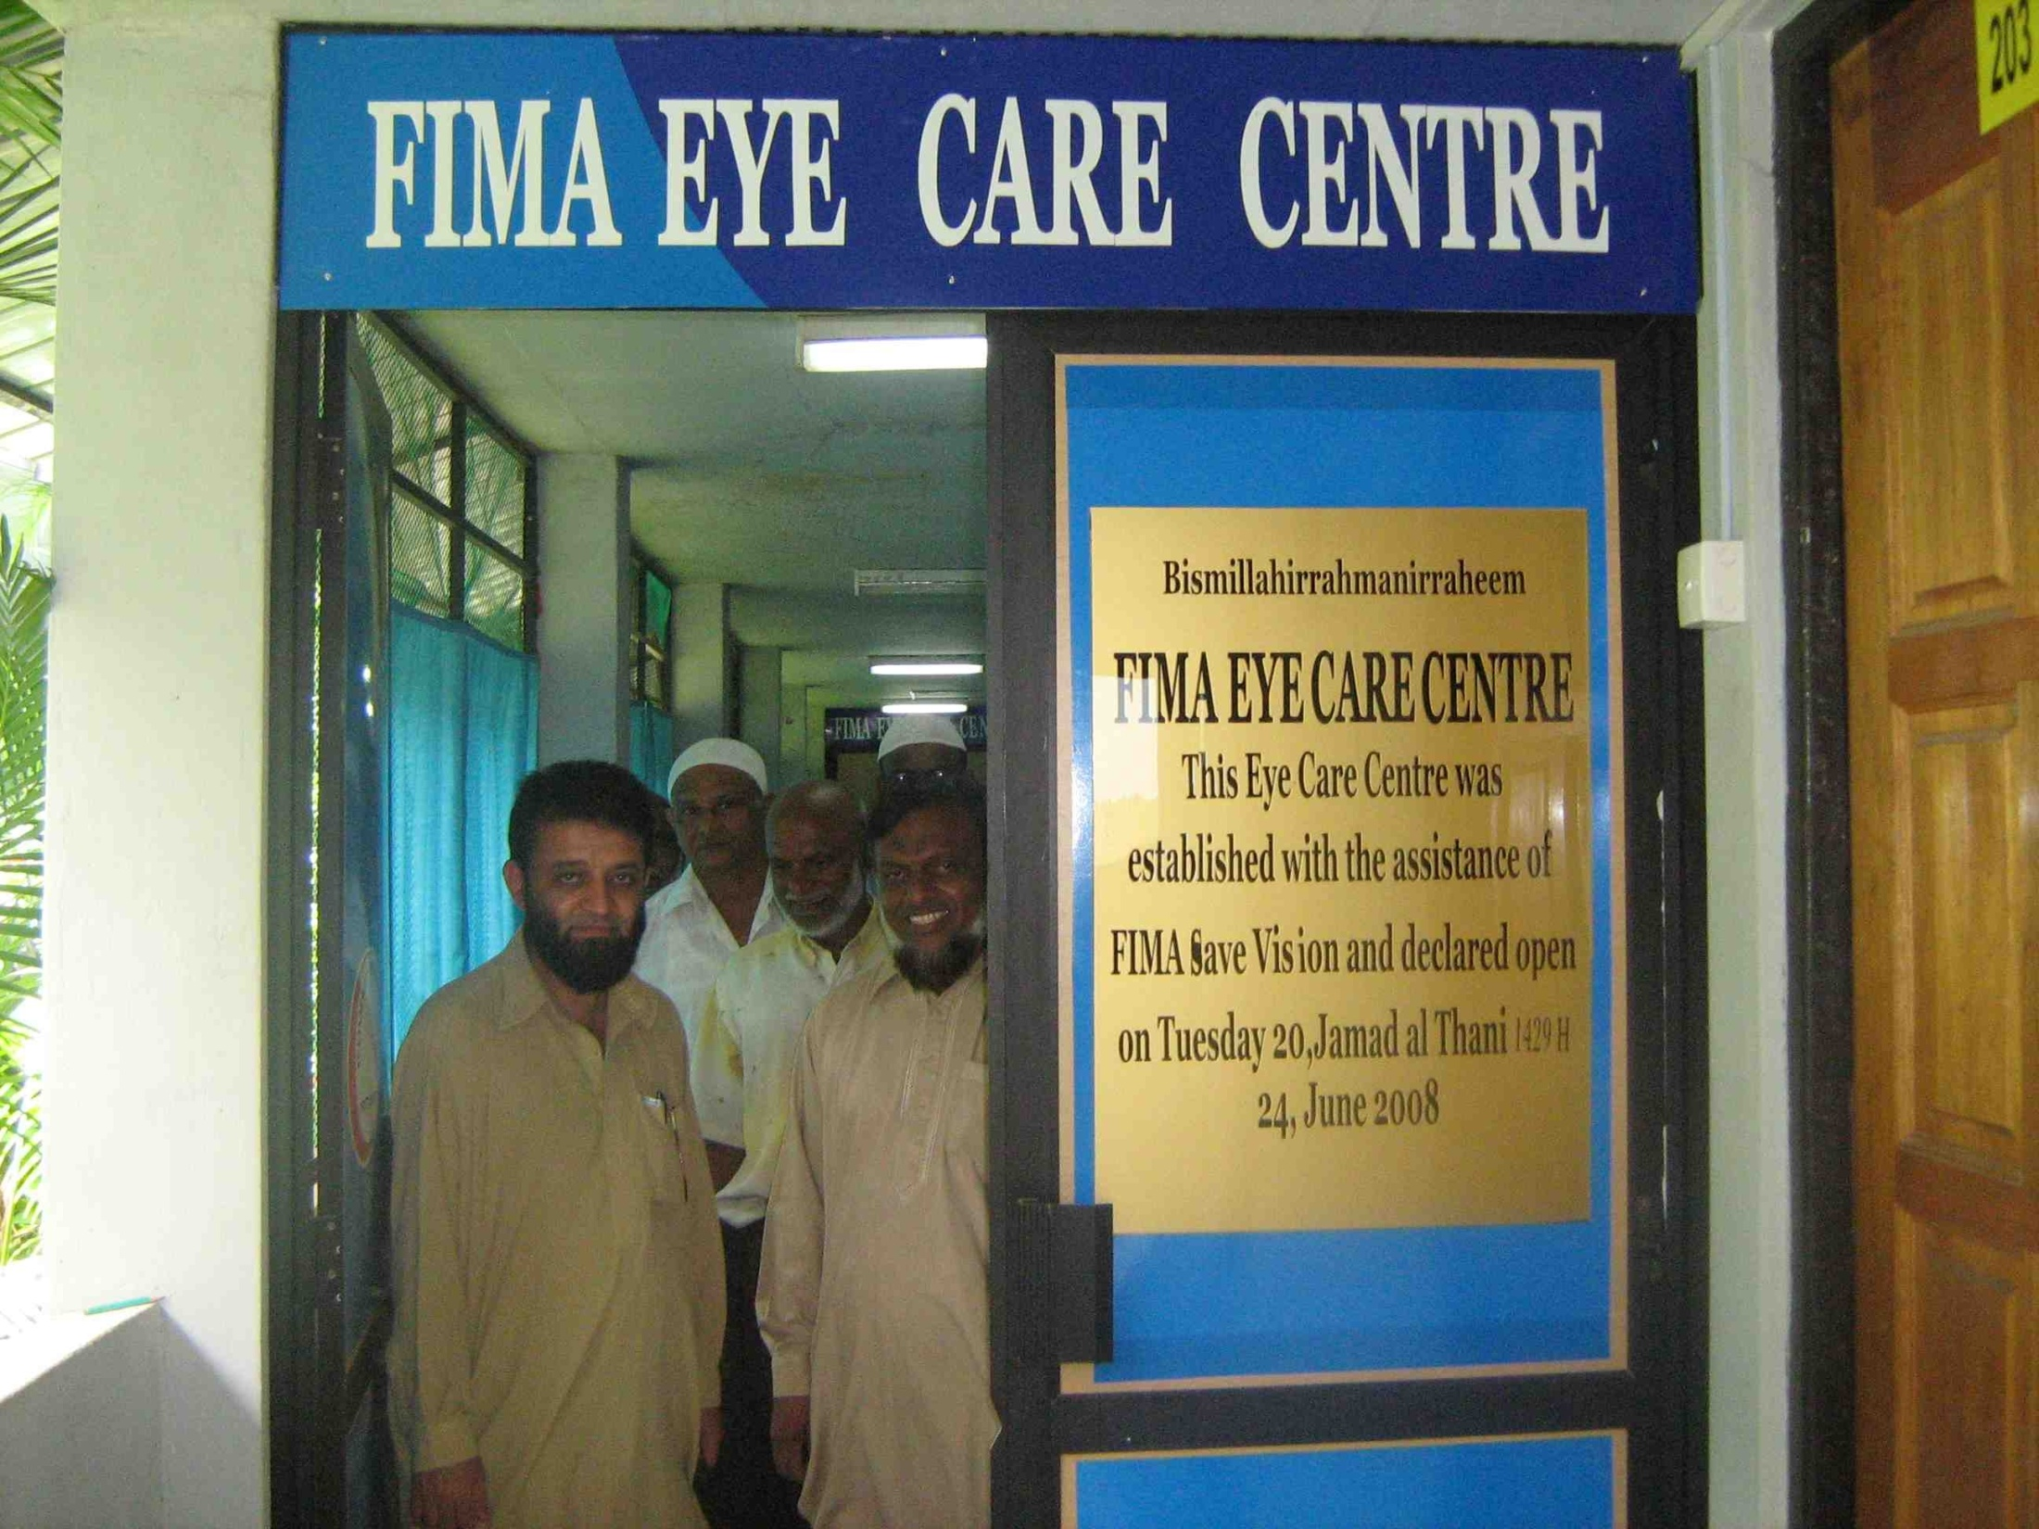

Slide 55
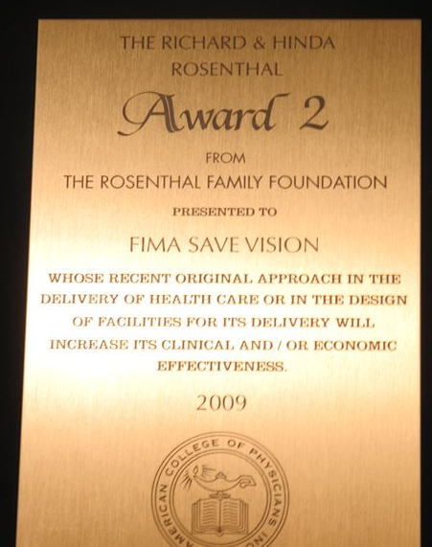
QUEST FOR
EXCELLENCE

Slide 56


Slide 57


Slide 58


Slide 59


FIMA SAVE SMILE
Bilateral Cleft Lip

Slide 60


Wide Cleft Lip Repaired

Slide 61


28 days old baby with Cleft Lip & Palate
Before
After

Slide 62


48 year old blind imam with Cleft Lip

Slide 63

With Happy Parents

Slide 64

FIMA Save Smile
DWW-Turkey & IMANA in Gaza

Slide 65




Slide 66


Slide 68

FIMA SAVE DIGNITY Dec 2008
ARAB MEDICAL UNION - 31 cases

Slide 69

FIMA SAVE DIGNITY
March 2010: 48 cases

Slide 70


Slide 71


Slide 72


Slide 73
AWARENESS
Articles in mass media, radio interviews, social media, e-blasts
ENGAGEMENT
“Tell me and I may forget, teach me and I may remember, show me and I learn.” ~ Benjamin Franklin ~
PARTNERSHIP
Building advocate base
EMPOWERMENT
Giving ownership to others
Advocacy 101

Slide 74
Take Home Messages
Believe in the ‘drip drip effect’
Be the voice of those without one
Use different platforms and approaches
You are here for a reason!
Use your networks
Share your knowledge

Slide 75


